Slide 1

Introduction to Operating Systems CS/COE 1550
Fall 2021
Sherif Khattab
ksm73@pitt.edu
(Some slides are from Silberschatz, Galvin and Gagne ©2013)

Slide 2
Announcements
Upcoming deadlines:
11/5: Homework 7 and Quiz 2
11/8: Lab 3
11/19: Project 3

Slide 3
Previous Lecture …
Virtual Memory
Address translation
Paging
Page Table
Page replacement algorithms
Optimal
Not Recently Used

Slide 4
Muddiest Points (Address Translation)
What does the mmu do
I'd like to see some kind of mapping of the MMU working
Calculating last memory address using base/limit register values
How does a chunk of data know what page it is?
Can you explain again how processes can share virtual memory but not physical memory?
translation process
How to break apart a virtual address to map through the page table and find the physical address
can mmu only support one page replacement algorithm?
can we review address translation with page table?

Slide 5
Muddiest Points (Page Replacement Algorithms)
why is page replacement necessary again
NRU
NRU page classes
how does hardware set dirty and reference bits in NRU?
What if there is a tie even after considering both the R and D bit
NRU vs LRU
The NRU Algorithm has a component of the algorithm at 3 different times; is this true for all page replacement algorithms?
Optimal Page replacement
OPT examples

Slide 6
Muddiest Points (Paging and Page Table Entry PTE)
How is a page table corresponding to a process
Why is the dirty bit necessary
What does it mean if it is dirty
R bit and D bit
Is it ever necessary to track how many times a page was accessed rather than just flipping the R bit?
What is the protection info in the page table entry?
how the tlb works

Slide 7
Today
Page Replacement Algorithms
FIFO
Second Chance
CLOCK
LRU
NFU
Aging
Working Set
WS-CLOCK

Slide 8
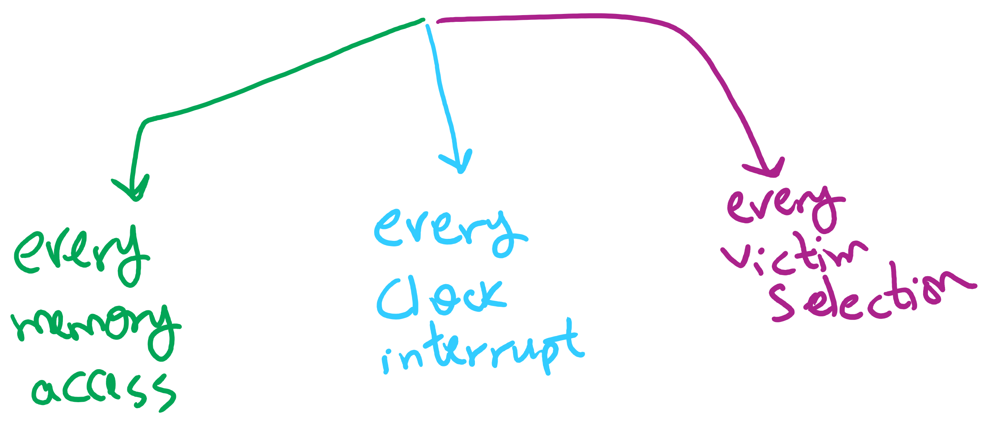
Page Replacement Algorithms Components

Slide 9
First-In, First-Out (FIFO) algorithm
Maintain a linked list of all pages
Maintain the order in which they entered memory
Page at front of list replaced
Advantage: (really) easy to implement
Disadvantage: page in memory the longest may be often used
This algorithm forces pages out regardless of usage
Usage may be helpful in determining which pages to keep

Slide 10
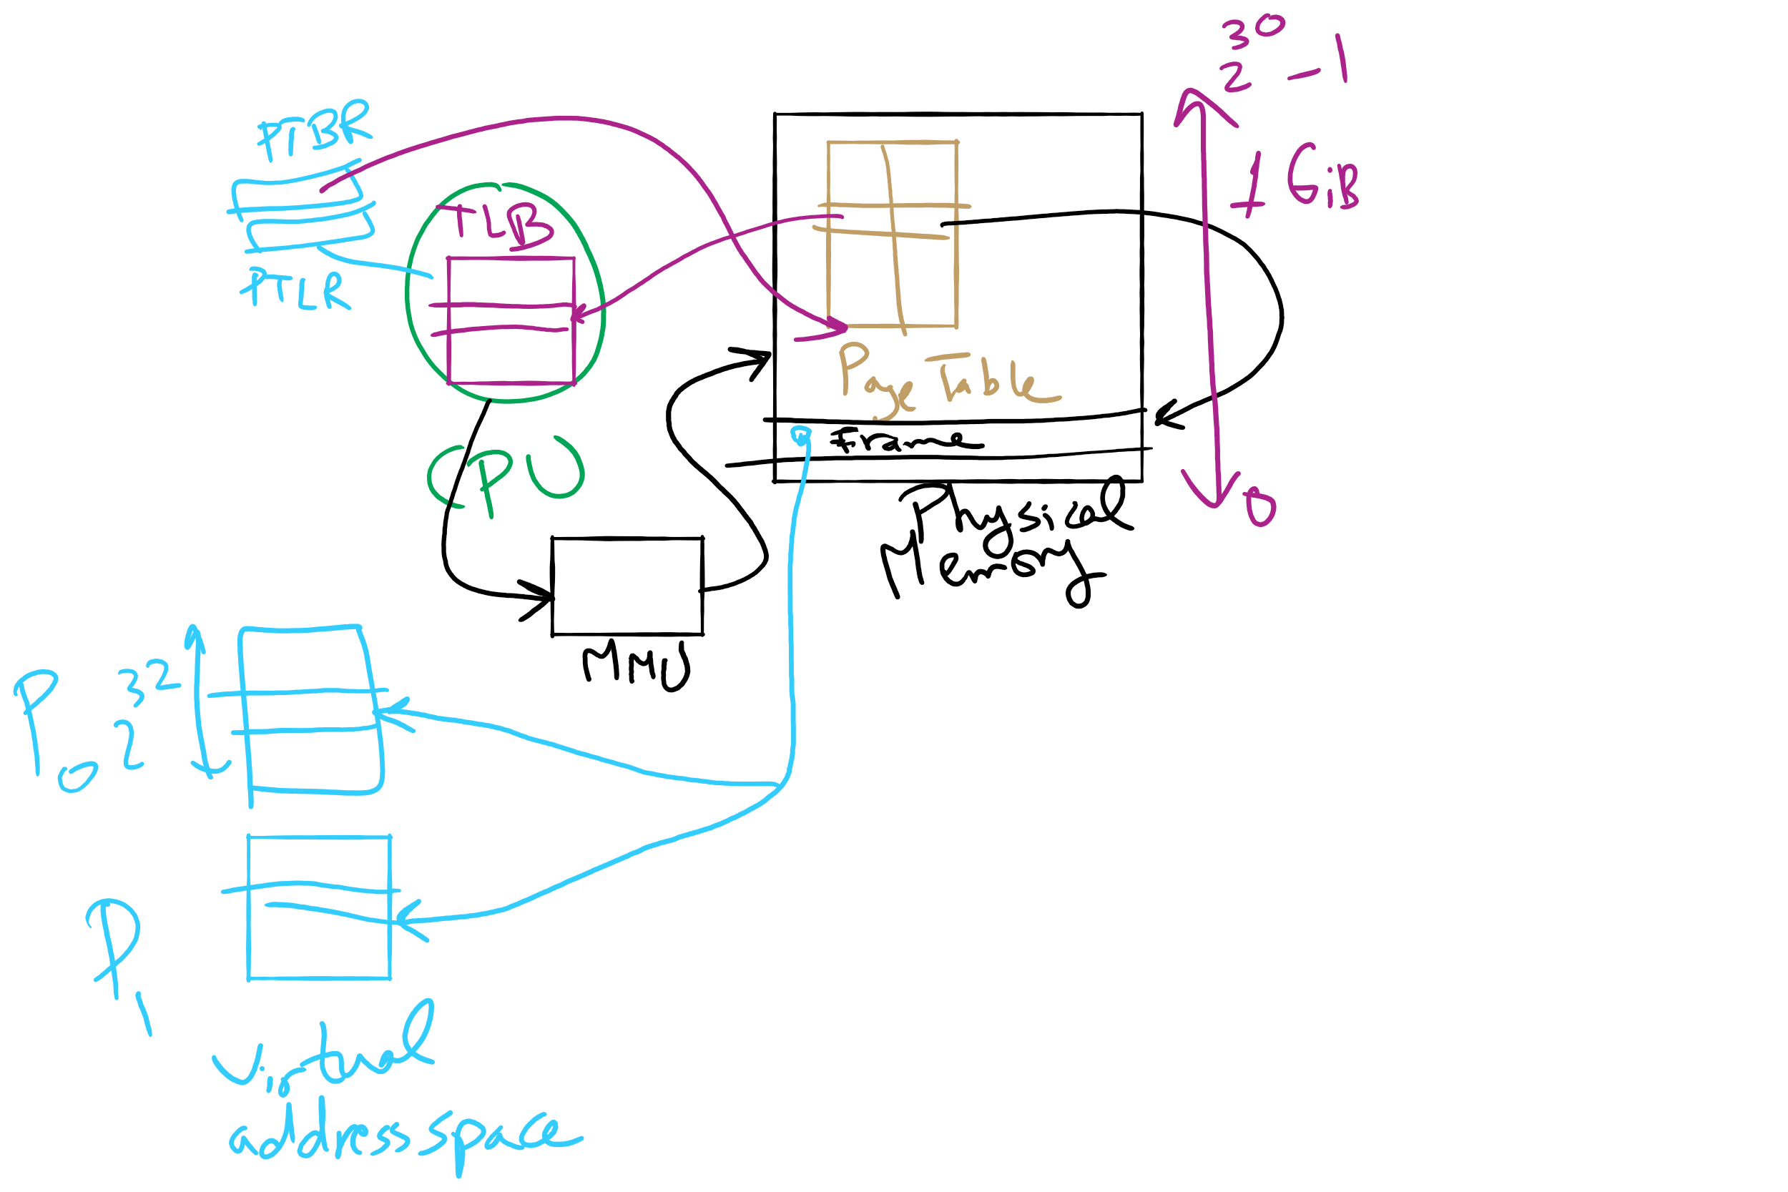
Address Translation

Slide 11
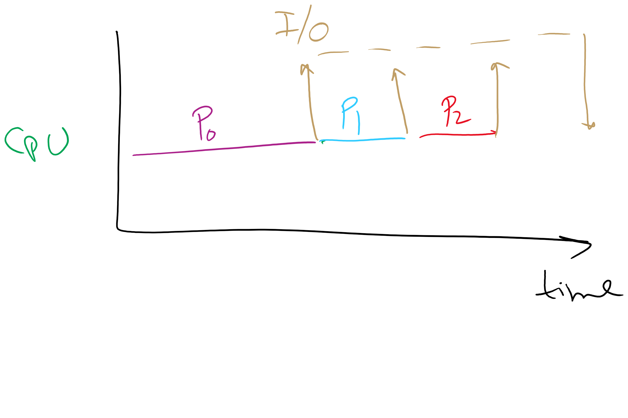
Why are more processes needed for higher CPU utilization?

Slide 12
Second chance page replacement
Modify FIFO to avoid throwing out heavily used pages
If reference bit is 0, throw the page out
If reference bit is 1
Reset the reference bit to 0
Move page to the tail of the list
Continue search for a free page
Still easy to implement, and better than plain FIFO
referenced
unreferenced
A t=0
B t=4
C t=8
D t=15
E t=21
F t=22
G t=29
H t=30
A t=32

Slide 13
Clock algorithm
Same functionality as second chance
Simpler implementation
“Clock” hand points to next page to replace
If R=0, replace page
If R=1, set R=0 and advance the clock hand
Continue until page with R=0 is found
This may involve going all the way around the clock…
A t=0
A t=32
H t=30
B t=4
B t=32
G t=29
C t=8
C t=32
F t=22
D t=15
J t=32
E t=21
referenced
unreferenced

Slide 14
Least Recently Used (LRU)
Assume pages used recently will be used again soon
Throw out page that has been unused for longest time
Must keep a linked list of pages
Most recently used at front, least at rear
Update this list every memory reference!
This can be somewhat slow: hardware has to update a linked list on every reference!
Alternatively, keep counter in each page table entry
Global counter increments with each CPU cycle
Copy global counter to PTE counter on a reference to the page
For replacement, evict page with lowest counter value

Slide 15
Simulating LRU in software
Few computers have the necessary hardware to implement full LRU
Linked-list method impractical in hardware
Counter-based method could be done, but it’s slow to find the desired page
Approximate LRU with Not Frequently Used (NFU) algorithm
At each clock interrupt, scan through page table
If R=1 for a page, add one to its counter value
On replacement, pick the page with the lowest counter value
Problem: no notion of age—pages with high counter values will tend to keep them!

Slide 16
Aging replacement algorithm
Reduce counter values over time
Divide by two every clock cycle (use right shift)
More weight given to more recent references!
Select page to be evicted by finding the lowest counter value
Algorithm is:
Every clock tick, shift all counters right by 1 bit
On reference, set leftmost bit of a counter (can be done by copying the reference bit to the counter at the clock tick)
Referenced this tick
Tick 0
Tick 1
Tick 2
Tick 3
Tick 4
Page 0
10000000
11000000
11100000
01110000
10111000
Page 1
00000000
10000000
01000000
00100000
00010000
Page 2
10000000
01000000
00100000
10010000
01001000
Page 3
00000000
00000000
00000000
10000000
01000000
Page 4
10000000
01000000
10100000
11010000
01101000
Page 5
10000000
11000000
01100000
10110000
11011000

Slide 17
Working set
Demand paging: bring a page into memory when it’s requested by the process
How many pages are needed?
Could be all of them, but not likely
Instead, processes reference a small set of pages at any given time—locality of reference
Set of pages can be different for different processes or even different times in the running of a single process
Set of pages used by a process in a given interval of time is called the working set
If entire working set is in memory, no page faults!
If insufficient space for working set, thrashing may occur
Goal: keep most of working set in memory to minimize the number of page faults suffered by a process

Slide 18
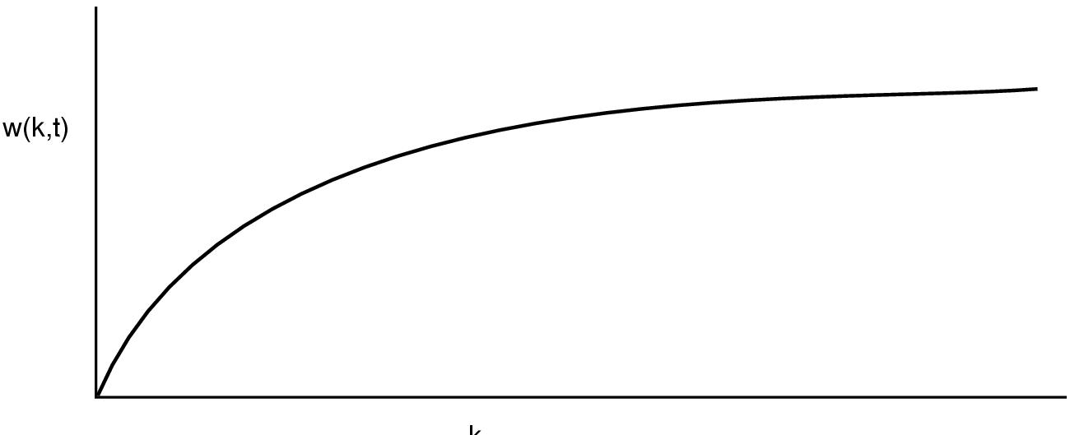
How big is the working set?
w(k,t)
k
Working set is the set of pages used by the k most recent memory references
w(k,t) is the size of the working set at time t
Working set may change over time
Size of working set can change over time as well…

Slide 19
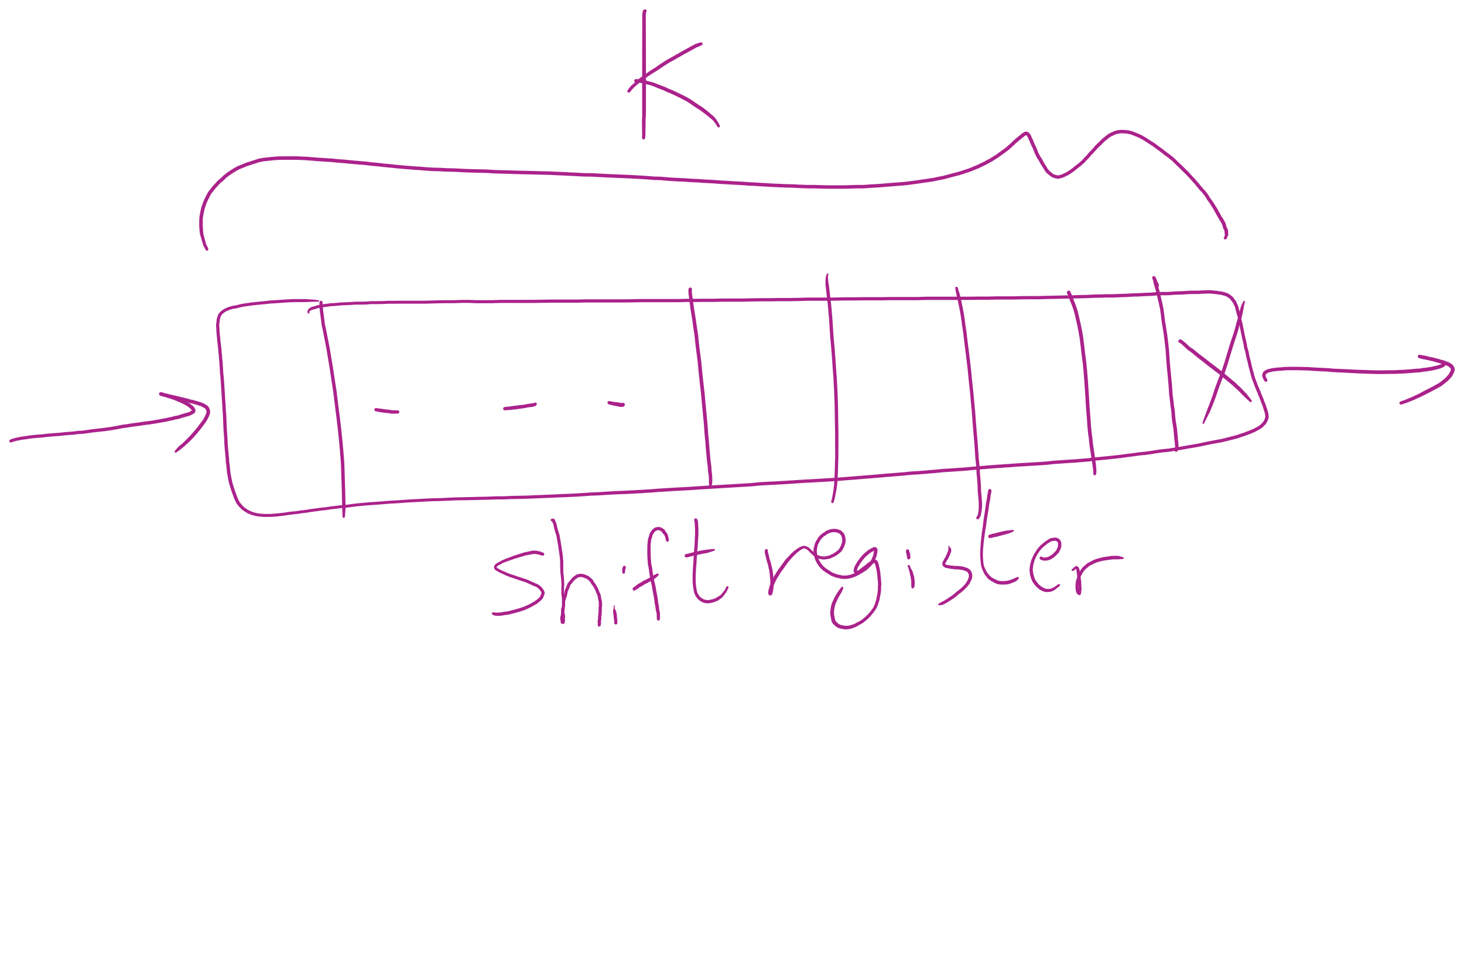
Keeping track of the Working Set

Slide 20
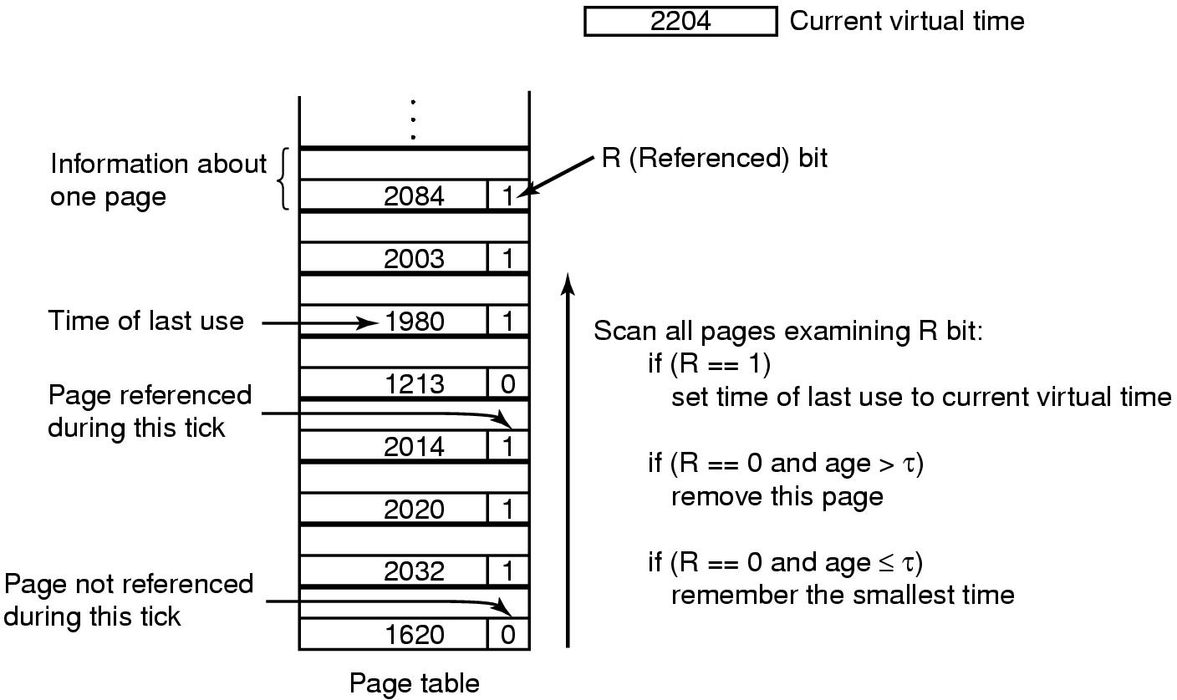
Working set page replacement algorithm

Slide 21
Page replacement algorithms: summary
Algorithm | Comment
OPT (Optimal) | Not implementable, but useful as a benchmark
NRU (Not Recently Used) | Crude
FIFO (First-In, First Out) | Might throw out useful pages
Second chance | Big improvement over FIFO
Clock | Better implementation of second chance
LRU (Least Recently Used) | Excellent, but hard to implement exactly
NFU (Not Frequently Used) | Poor approximation to LRU
Aging | Good approximation to LRU, efficient to implement
Working Set | Somewhat expensive to implement
WSClock | Implementable version of Working Set

Slide 22
Modeling page replacement algorithms
Goal: provide quantitative analysis (or simulation) showing which algorithms do better
Workload (page reference string) is important: different strings may favor different algorithms
Show tradeoffs between algorithms
Compare algorithms to one another
Model parameters within an algorithm
Number of available physical pages
Number of bits for aging

Slide 23
How is modeling done?
Generate a list of references
Artificial (made up)
Trace a real workload (set of processes)
Use an array (or other structure) to track the pages in physical memory at any given time
May keep other information per page to help simulate the algorithm (modification time, time when paged in, etc.)
Run through references, applying the replacement algorithm
Example: FIFO replacement on reference string 0 1 2 3 0 1 4 0 1 2 3 4
Page replacements highlighted in yellow
Page referenced |  | 0 | 1 | 2 | 3 | 0 | 1 | 4 | 0 | 1 | 2 | 3 | 4
Youngest page |  | 0 | 1 | 2 | 3 | 0 | 1 | 4 | 4 | 4 | 2 | 3 | 3
 |  |  | 0 | 1 | 2 | 3 | 0 | 1 | 1 | 1 | 4 | 2 | 2
Oldest page |  |  |  | 0 | 1 | 2 | 3 | 0 | 0 | 0 | 1 | 4 | 4

Slide 24
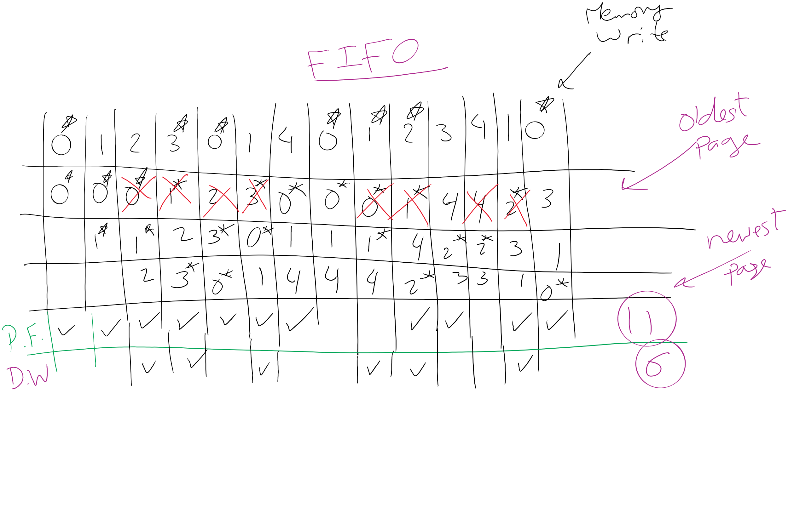
FIFO Example 1

Slide 25
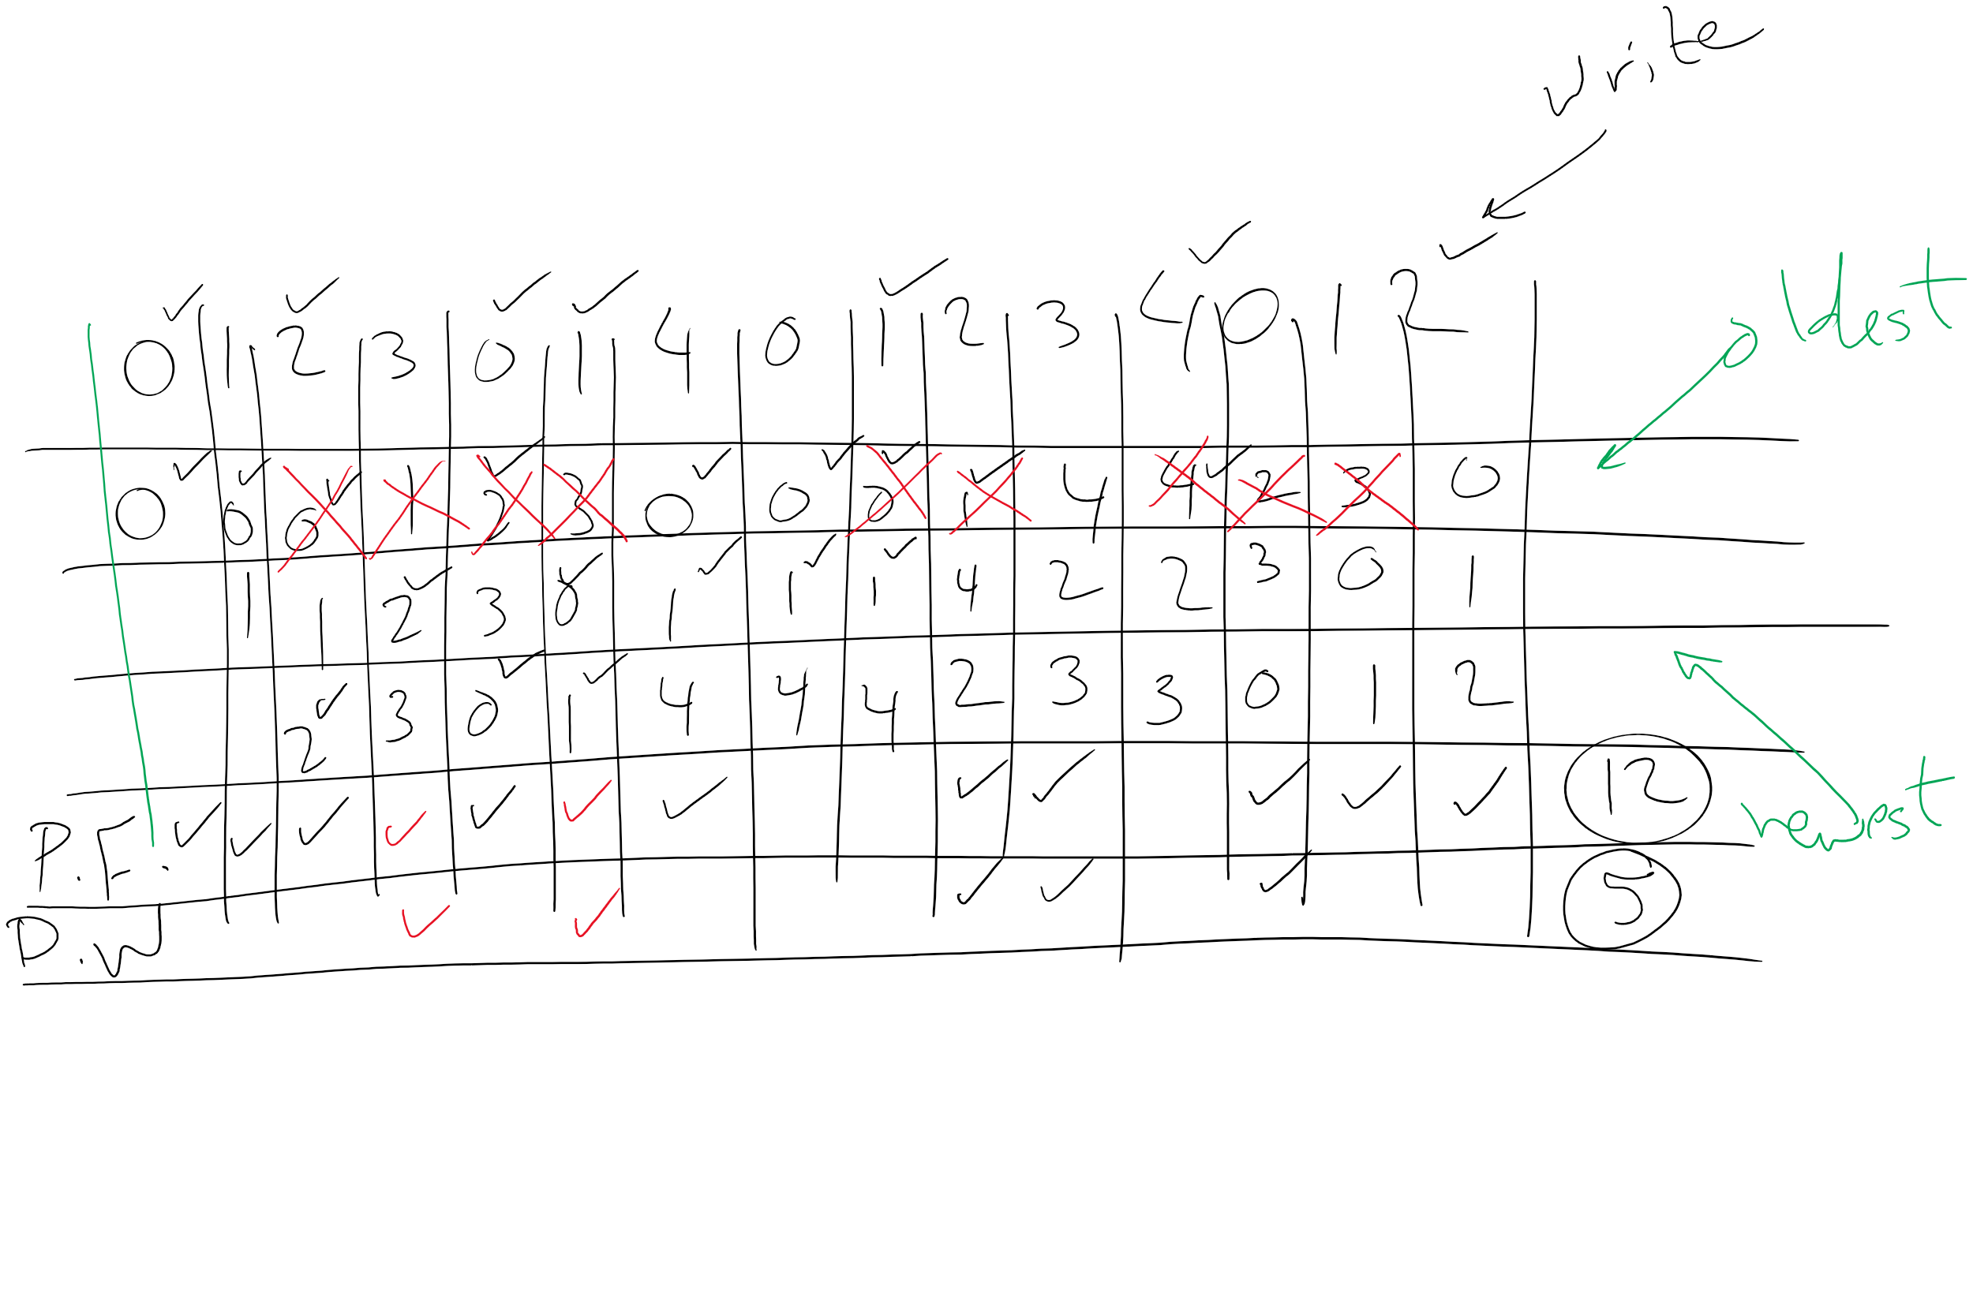
FIFO Example 2

Slide 26
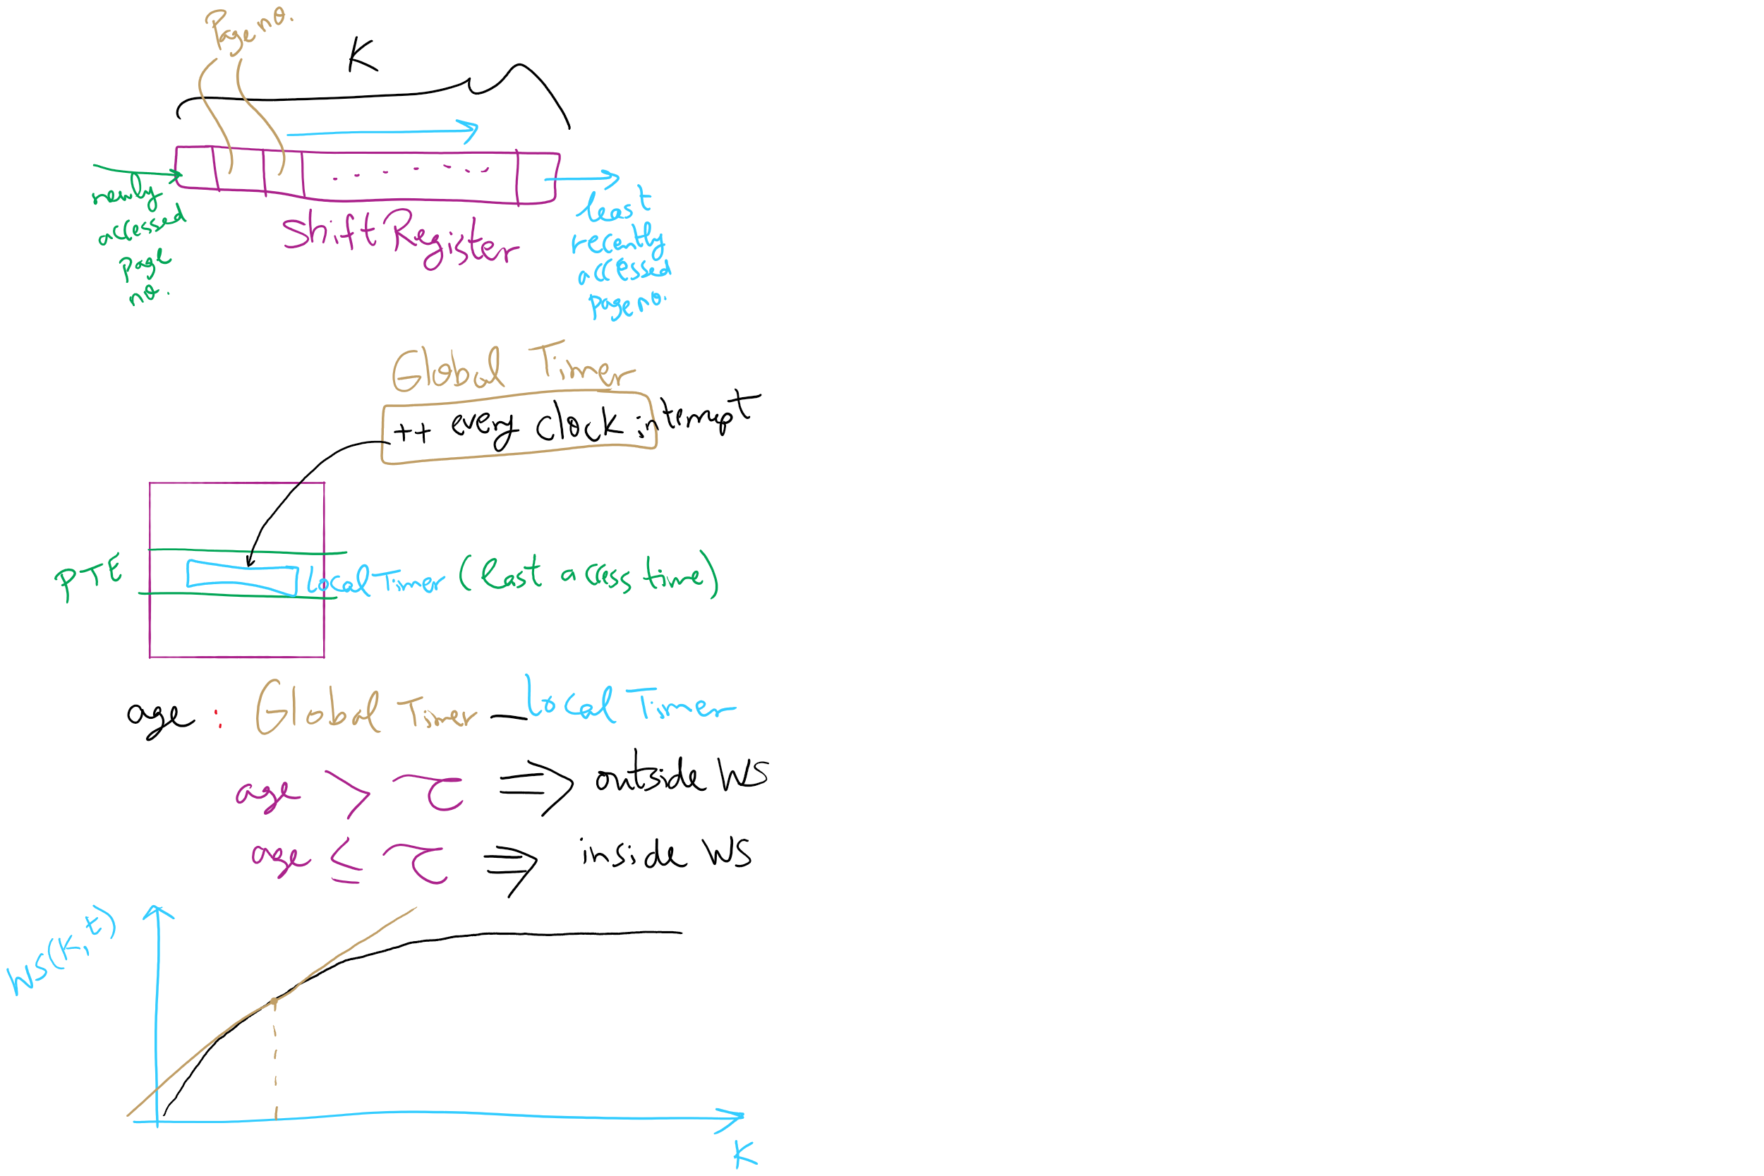
Working Set Algorithm

Slide 27
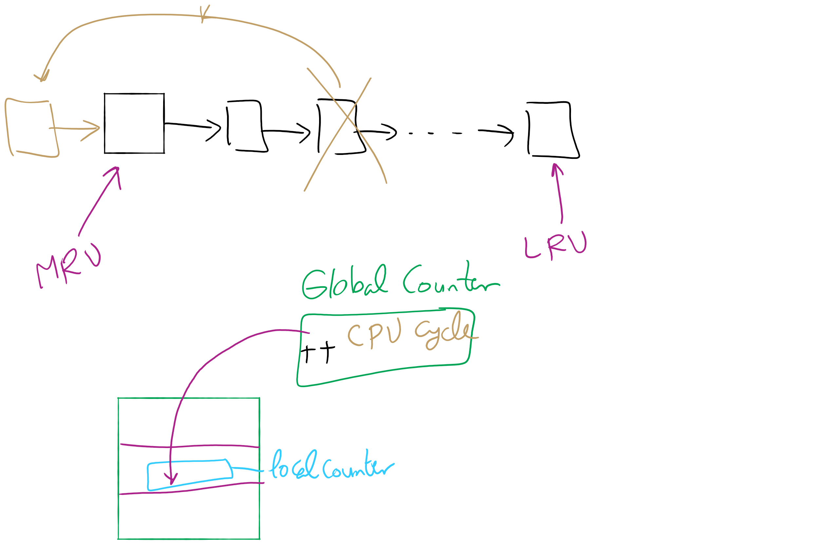
LRU

Slide 28
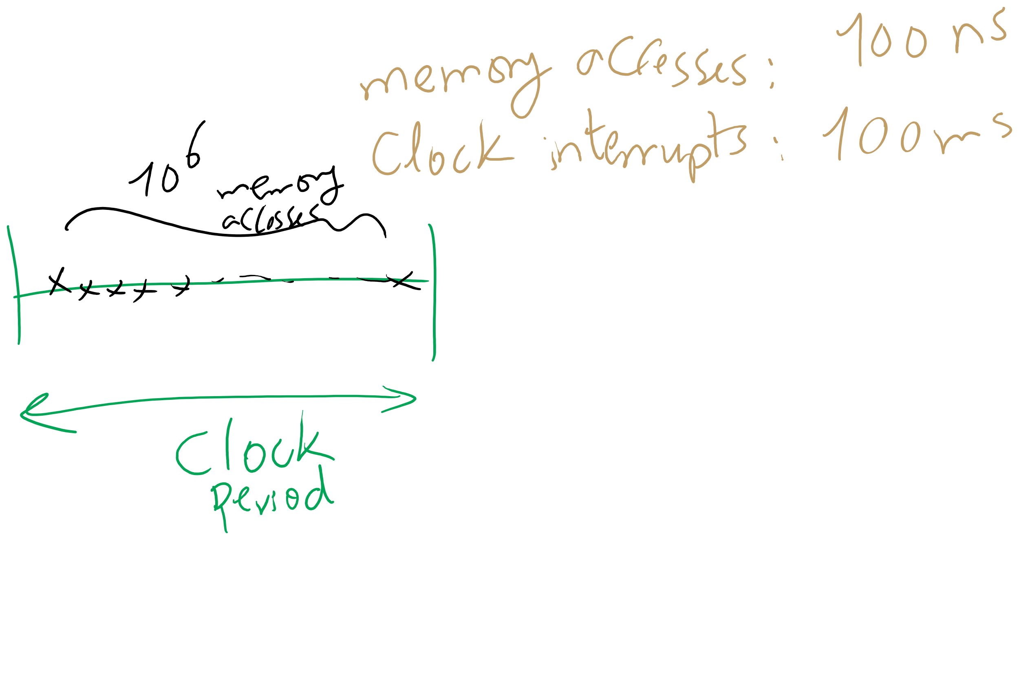
NFU

Slide 29
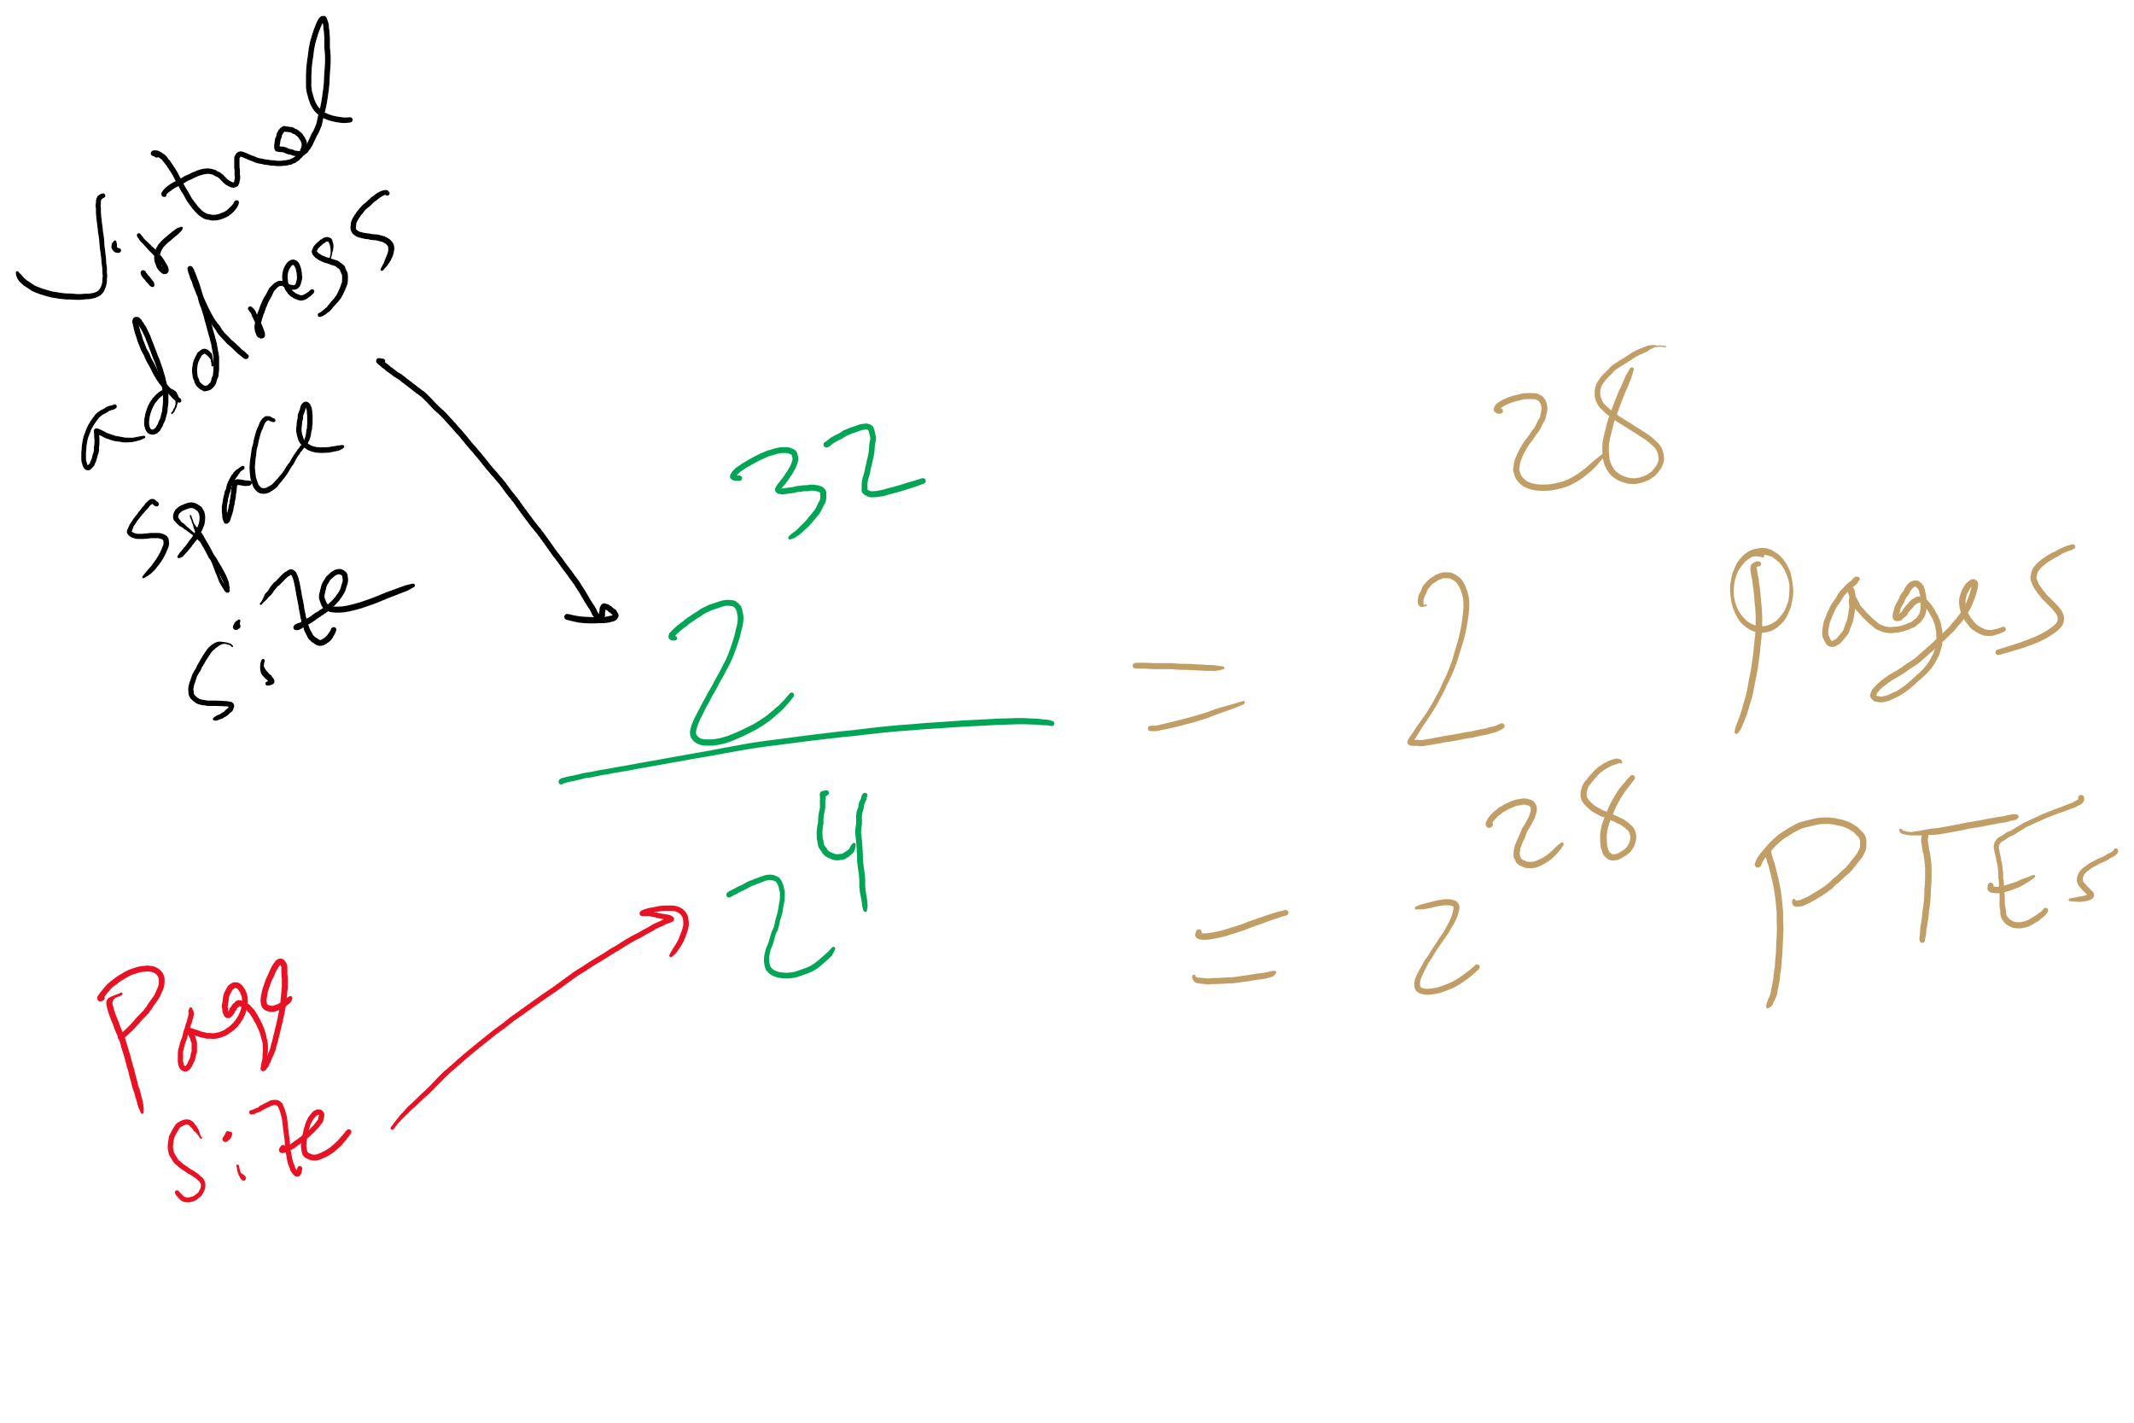
HW 8 Q11

Slide 30
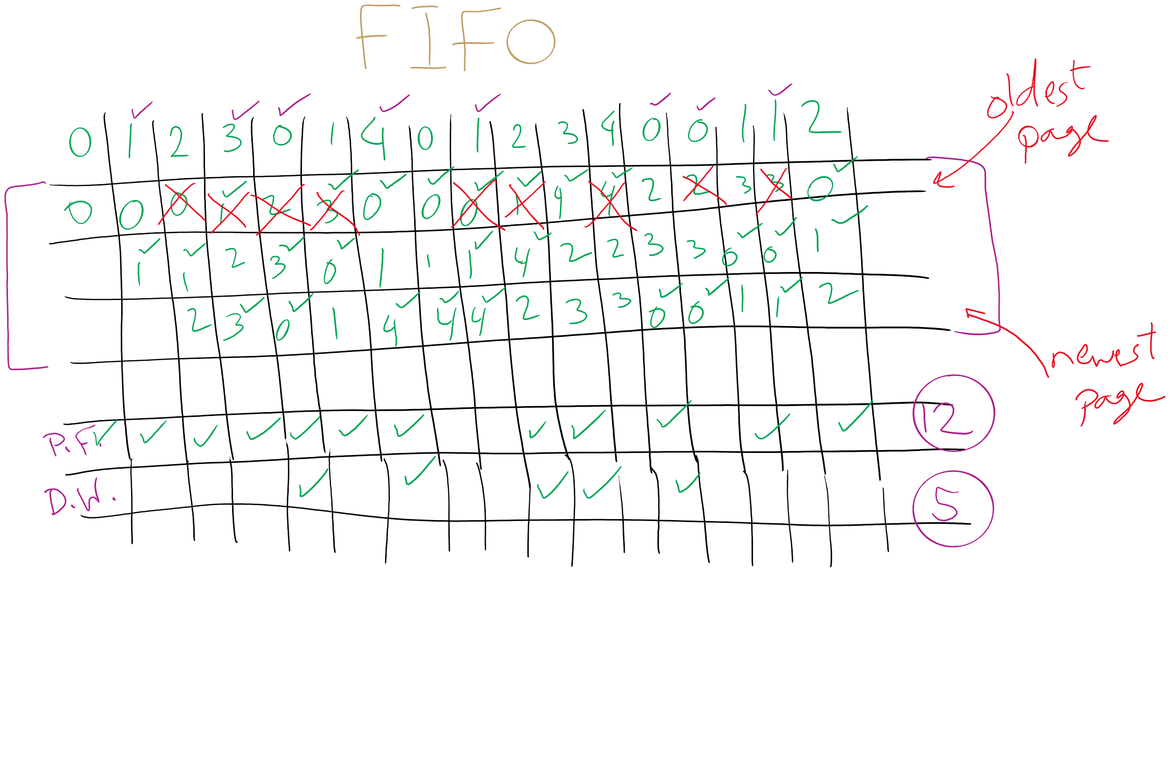
FIFO with 3 frames

Slide 31
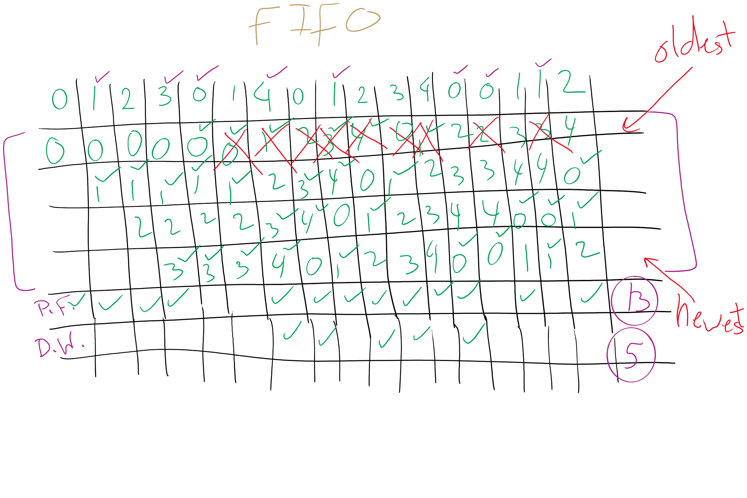
FIFO with 4 frames

Slide 32
Belady’s anomaly
Reduce the number of page faults by supplying more memory
Use previous reference string and FIFO algorithm
Add another page to physical memory (total 4 pages)
More page faults (10 vs. 9), not fewer!
This is called Belady’s anomaly
Adding more pages shouldn’t result in worse performance!
Motivated the study of paging algorithms
Page referenced |  | 0 | 1 | 2 | 3 | 0 | 1 | 4 | 0 | 1 | 2 | 3 | 4
Youngest page |  | 0 | 1 | 2 | 3 | 3 | 3 | 4 | 0 | 1 | 2 | 3 | 4
 |  |  | 0 | 1 | 2 | 2 | 2 | 3 | 4 | 0 | 1 | 2 | 3
 |  |  |  | 0 | 1 | 1 | 1 | 2 | 3 | 4 | 0 | 1 | 2
Oldest page |  |  |  |  | 0 | 0 | 0 | 1 | 2 | 3 | 4 | 0 | 1

Slide 33
Modeling more replacement algorithms
Paging system characterized by:
Reference string of executing process
Page replacement algorithm
Number of page frames available in physical memory (m)
Model this by keeping track of all n pages referenced in array M
Top part of M has m pages in memory
Bottom part of M has n-m pages stored on disk
Page replacement occurs when page moves from top to bottom
Top and bottom parts may be rearranged without causing movement between memory and disk

Slide 34
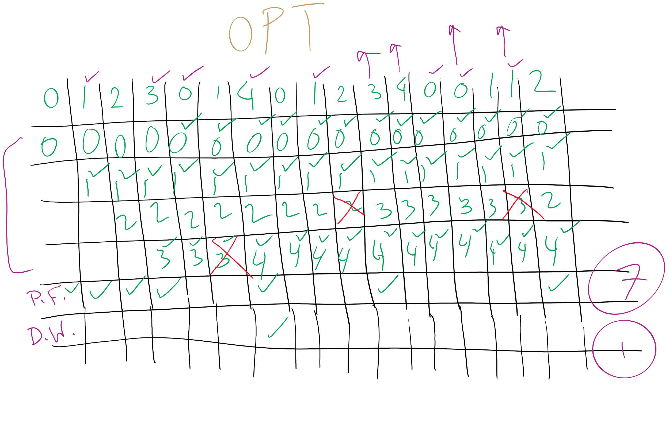
OPT

Slide 35
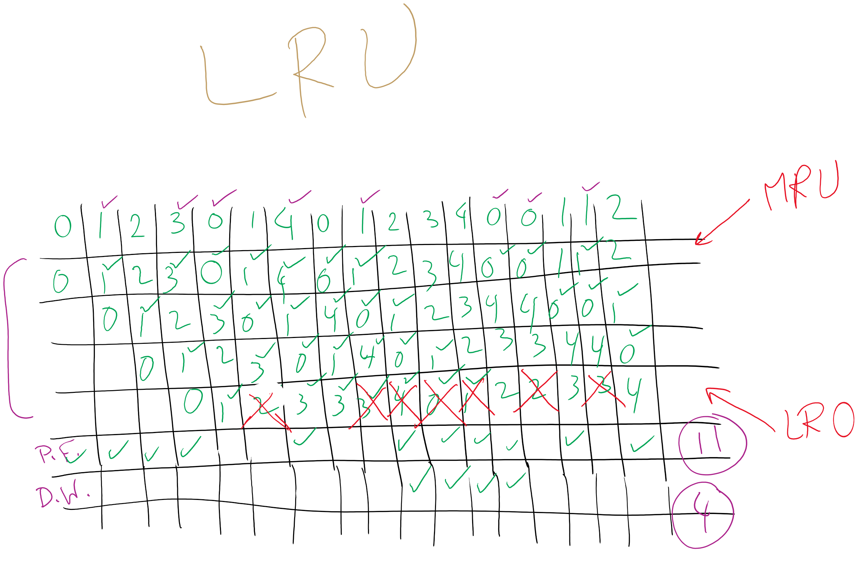
LRU

Slide 36
Example: LRU
Model LRU replacement with
8 unique references in the reference string
4 pages of physical memory
Array state over time shown below
LRU treats list of pages like a stack
 | 0 | 2 | 1 | 3 | 5 | 4 | 6 | 3 | 7 | 4 | 7 | 3 | 3 | 5 | 5 | 3 | 1 | 1 | 1 | 7 | 1 | 3 | 4 | 1
 | 0 | 2 | 1 | 3 | 5 | 4 | 6 | 3 | 7 | 4 | 7 | 3 | 3 | 5 | 5 | 3 | 1 | 1 | 1 | 7 | 1 | 3 | 4 | 1
 |  | 0 | 2 | 1 | 3 | 5 | 4 | 6 | 3 | 7 | 4 | 7 | 7 | 3 | 3 | 5 | 3 | 3 | 3 | 1 | 7 | 1 | 3 | 4
 |  |  | 0 | 2 | 1 | 3 | 5 | 4 | 6 | 3 | 3 | 4 | 4 | 7 | 7 | 7 | 5 | 5 | 5 | 3 | 3 | 7 | 1 | 3
 |  |  |  | 0 | 2 | 1 | 3 | 5 | 4 | 6 | 6 | 6 | 6 | 4 | 4 | 4 | 7 | 7 | 7 | 5 | 5 | 5 | 7 | 7
 |  |  |  |  | 0 | 2 | 1 | 1 | 5 | 5 | 5 | 5 | 5 | 6 | 6 | 6 | 4 | 4 | 4 | 4 | 4 | 4 | 5 | 5
 |  |  |  |  |  | 0 | 2 | 2 | 1 | 1 | 1 | 1 | 1 | 1 | 1 | 1 | 6 | 6 | 6 | 6 | 6 | 6 | 6 | 6
 |  |  |  |  |  |  | 0 | 0 | 2 | 2 | 2 | 2 | 2 | 2 | 2 | 2 | 2 | 2 | 2 | 2 | 2 | 2 | 2 | 2
 |  |  |  |  |  |  |  |  | 0 | 0 | 0 | 0 | 0 | 0 | 0 | 0 | 0 | 0 | 0 | 0 | 0 | 0 | 0 | 0

Slide 37
Stack algorithms
LRU is an example of a stack algorithm
For stack algorithms
Any page in memory with m physical pages is also in memory with m+1 physical pages
Increasing memory size is guaranteed to reduce (or at least not increase) the number of page faults
Stack algorithms do not suffer from Belady’s anomaly
Distance of a reference == position of the page in the stack before the reference was made
Distance is ∞ if no reference had been made before
Distance depends on reference string and paging algorithm: might be different for LRU and optimal (both stack algorithms)

Slide 38
Predicting page fault rates using distance
Distance can be used to predict page fault rates
Make a single pass over the reference string to generate the distance string on-the-fly
Keep an array of counts
Entry j counts the number of times distance j occurs in the distance string
The number of page faults for a memory of size m is the sum of the counts for j>m
This can be done in a single pass!
Makes for fast simulations of page replacement algorithms
This is why virtual memory theorists like stack algorithms!

Slide 39
Mapping logical => physical address
Split address from CPU into two pieces
Page number (p)
Page offset (d)
Page number
Index into page table
Page table contains base address of page in physical memory
Page offset
Added to base address to get actual physical memory address
Page size = 2^{d} bytes
Example:
• 4 KB (=4096 byte) pages
• 32 bit logical addresses
2^{d} = 4096
d = 12
32-12 = 20 bits
12 bits
p
d
32 bit logical address

Slide 40
Address translation architecture
page number
Page frame number
Page frame number
page offset
0
CPU
p
d
f
d
1
. . .
0
f-1
1
f
. . .
f+1
p-1
f+2
p
f
. . .
p+1
physical memory
page table

Slide 41
Memory & paging structures
Physical memory
Page frame number
Page 0
6
Page 1
3
0
Page 1 (P1)
Page 2
4
1
Page 3
9
2
Page 4 (P0)
Page 4
2
3
Page 1 (P0)
Free
pages
4
Page 2 (P0)
Logical memory (P0)
Page table (P0)
5
6
Page 0 (P0)
Page 0
8
7
Page 1
0
8
Page 0 (P1)
9
Page 3 (P0)
Logical memory (P1)
Page table (P1)

Slide 42
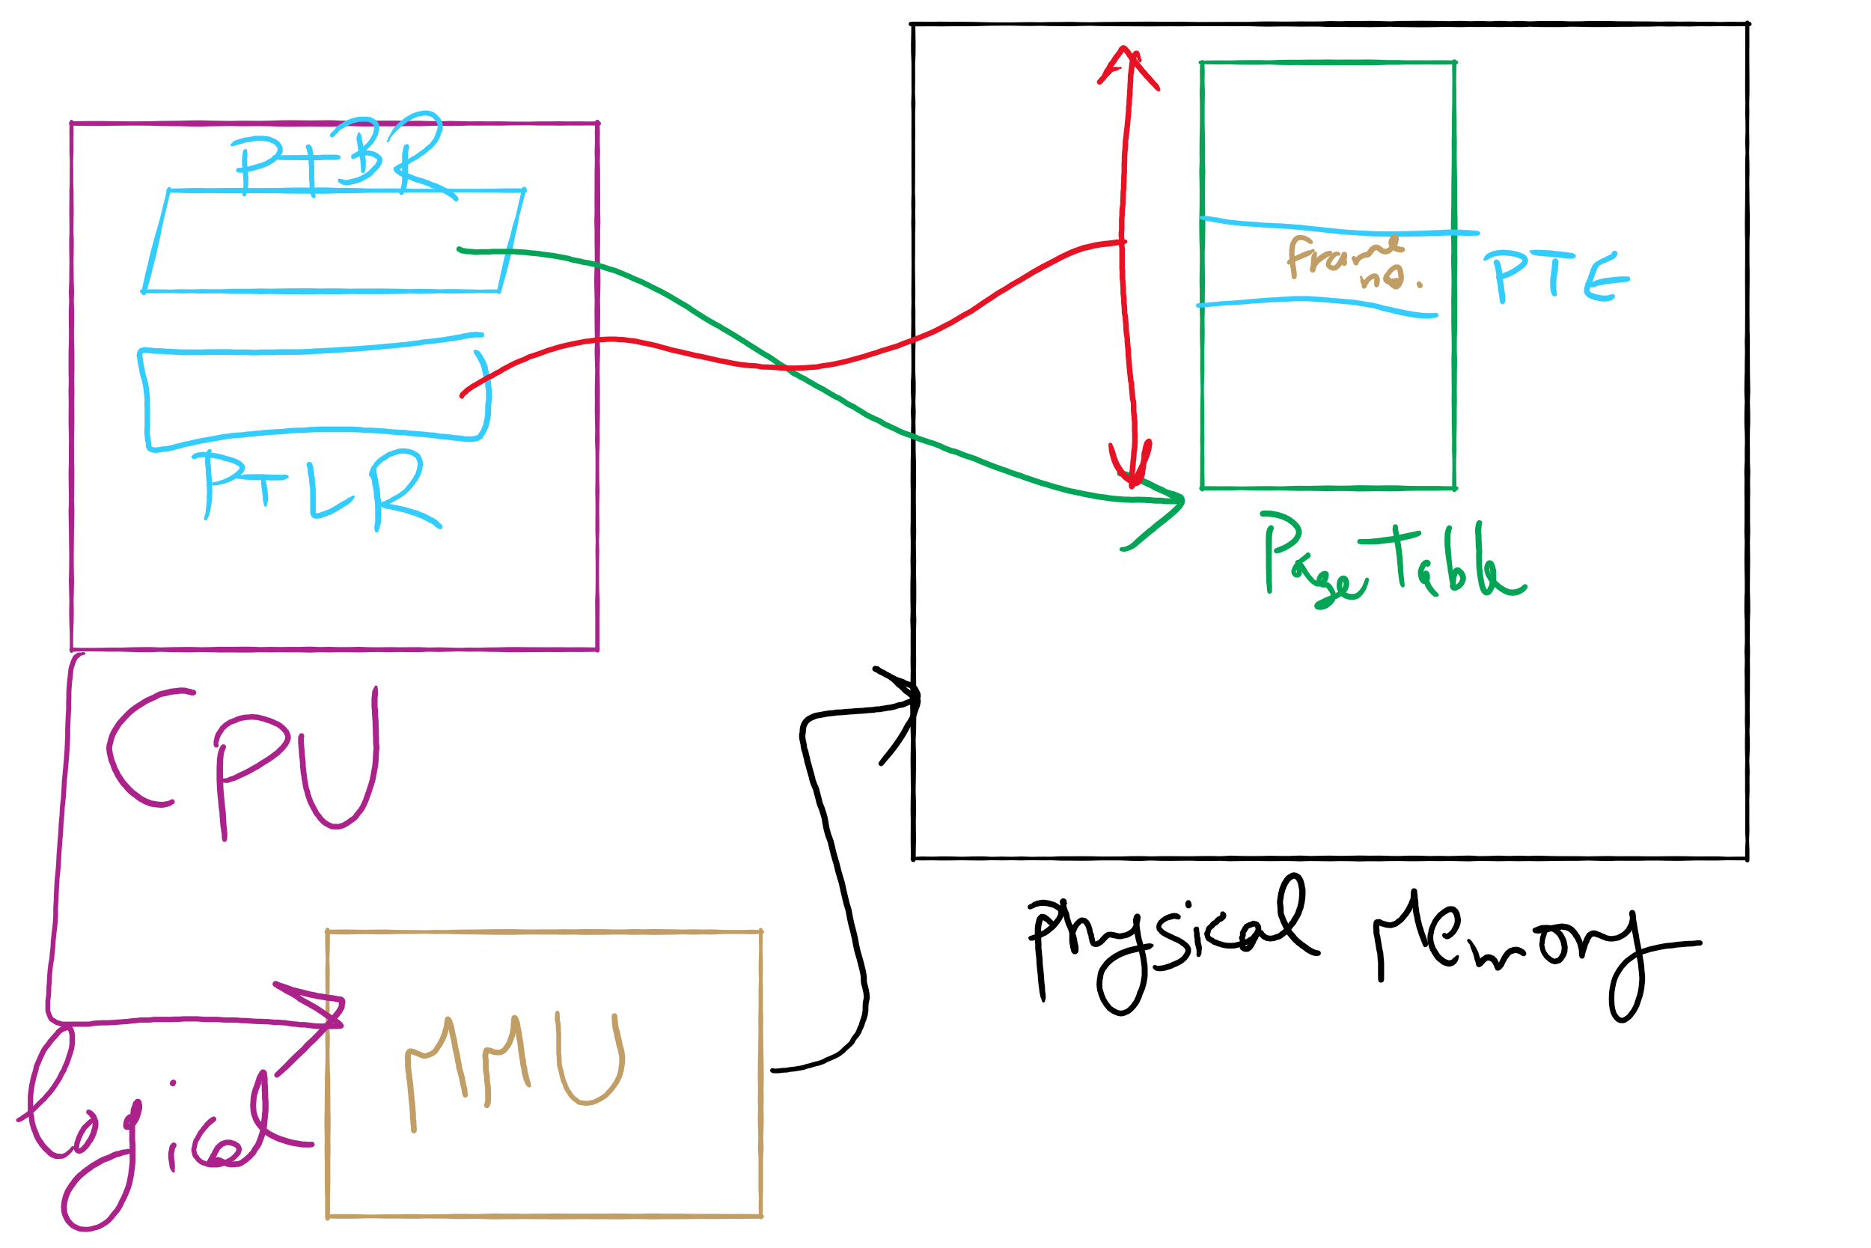
Address Translation Structures

Slide 43
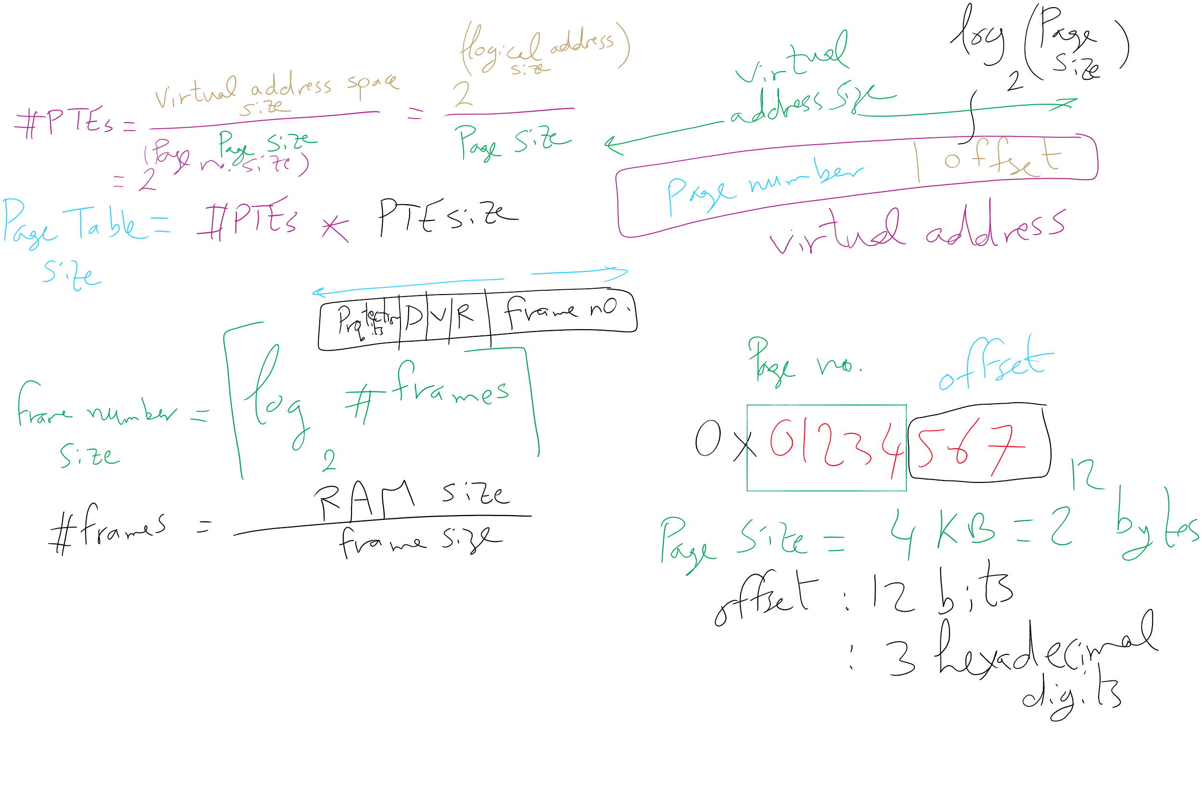
Address Translation Relations

Slide 44
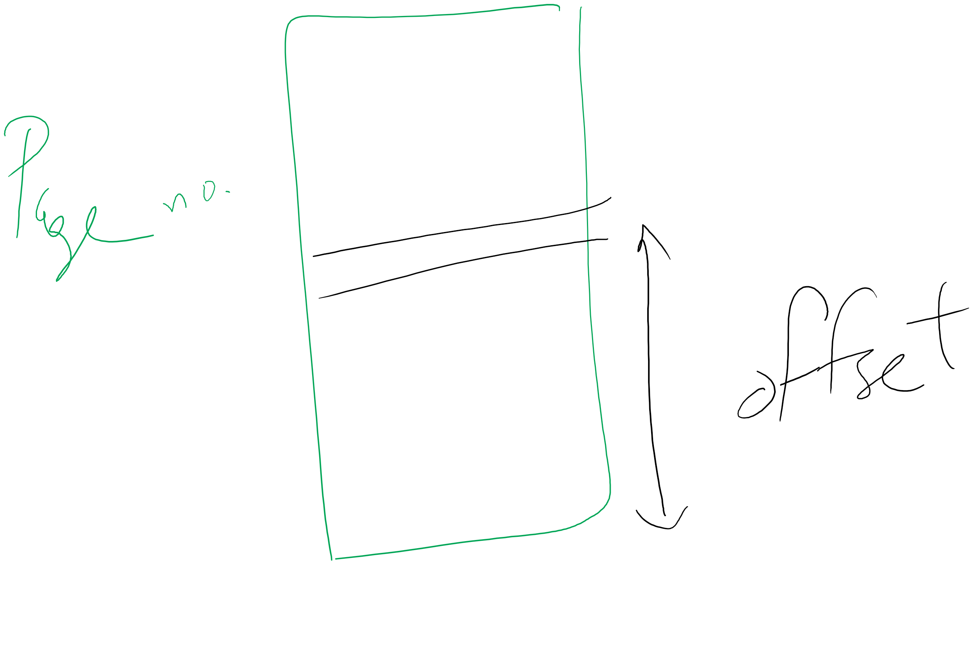
Page number vs. Offset

Slide 45
Muddiest Points (2/2)
HW 8
question 1
questions 6 and 7
Page Replacement Algorithms
Why do some algorithms suffer from Belady's anomaly and how do stack algorithms avoid this issue?
lru trace
Could you run through the LRU diagram example and explain how it works( from slide 9)
Stack Algorithms
Getting the number of page faults from the stack algorithm
distance in stack algorithm
What does it takes for the stack algorithm to save all of those
Why do we use distance in a 2D structure instead of a counter to keep track of page faults?
what are some other stack algorithms?
How are the distances in memory used to count the number of page faults in LRU?
The logic behind adding extra rows for stack algorithms
How can you predict the number of page faults again?
Project 3
Getting it started
Creating the programming version of the paper solution sounds pretty abstract, but I think once I do it for myself it will clear more things up

Slide 46
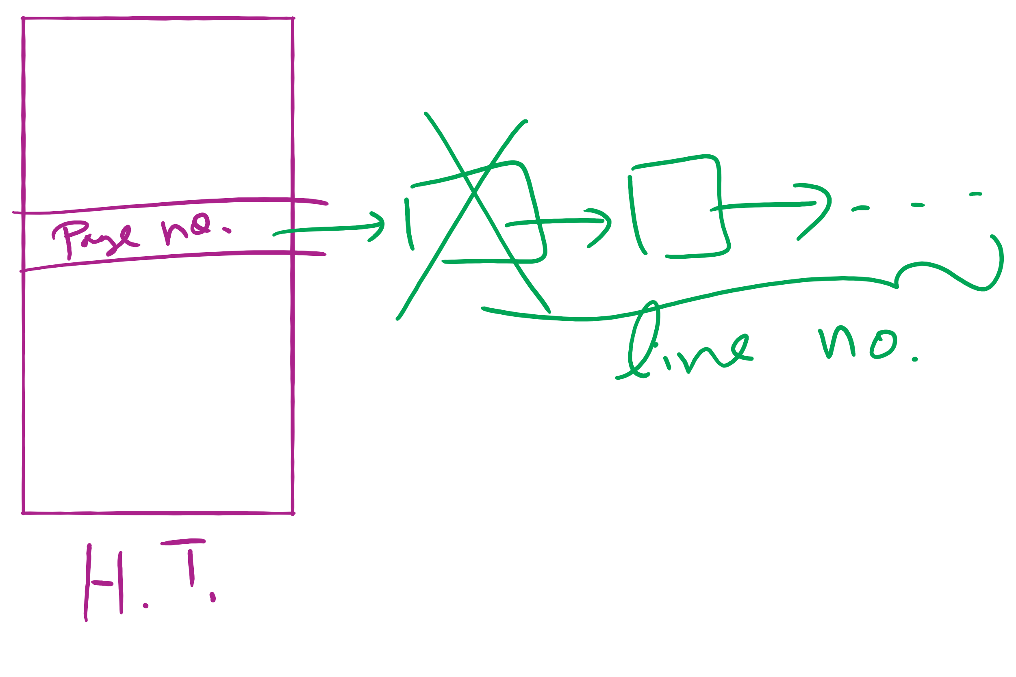
Hash Table for OPT in Project 3

Slide 47
Two-level page tables
Problem: page tables can be too large
2³² bytes in 4KB pages need 1 million PTEs
Solution: use multi-level page tables
“Page size” in first page table is large (megabytes)
PTE marked invalid in first page table needs no 2nd level page table
1st level page table has pointers to 2nd level page tables
2nd level page table has actual physical page numbers in it
. . .
220
. . .
657
. . .
. . .
401
. . .
. . .
. . .
125
613
. . .
. . .
. . .
1st level page table
961
. . .
884
960
. . .
2nd level page tables
. . .
main memory
955

Slide 48
More on two-level page tables
Tradeoffs between 1st and 2nd level page table sizes
Total number of bits indexing 1st and 2nd level table is constant for a given page size and logical address length
Tradeoff between number of bits indexing 1st and number indexing 2nd level tables
More bits in 1st level: fine granularity at 2nd level
Fewer bits in 1st level: maybe less wasted space?
All addresses in table are physical addresses
Protection bits kept in 2nd level table

Slide 49
Two-level paging: example
System characteristics
8 KB pages
32-bit logical address divided into 13 bit page offset, 19 bit page number
Page number divided into:
10 bit page number
9 bit page offset
Logical address looks like this:
p₁ is an index into the 1st level page table
p₂ is an index into the 2nd level page table pointed to by p₁
page number
page offset
p₁ = 10 bits
p₂ = 9 bits
offset = 13 bits

Slide 50
2-level address translation example
page number
page offset
p₁ = 10 bits
p₂ = 9 bits
offset = 13 bits
frame number
0
Page table base
physical address
1
0
19
13
. . .
1
. . .
0
1
p₁
. . .
. . .
. . .
p₂
main memory
1st level page table
. . .
2nd level page table

Slide 51
Translation Lookaside Buffer (TLB)
Search the TLB for the desired logical page number
Search entries in parallel
Use standard cache techniques
If desired logical page number is found, get frame number from TLB
If desired logical page number isn’t found
Get frame number from page table in memory
Replace an entry in the TLB with the logical & physical page numbers from this reference
Logical page #
Physical frame #
8
3
unused
2
1
3
0
12
12
29
6
22
11
7
4
Example TLB

Slide 52
Handling TLB misses
If PTE isn’t found in TLB, OS needs to do the lookup in the page table
Lookup can be done in hardware or software
Hardware TLB replacement
CPU hardware does page table lookup
Can be faster than software
Less flexible than software, and more complex hardware
Software TLB replacement
OS gets TLB exception
Exception handler does page table lookup & places the result into the TLB
Program continues after return from exception
Larger TLB (lower miss rate) can make this feasible

Slide 53
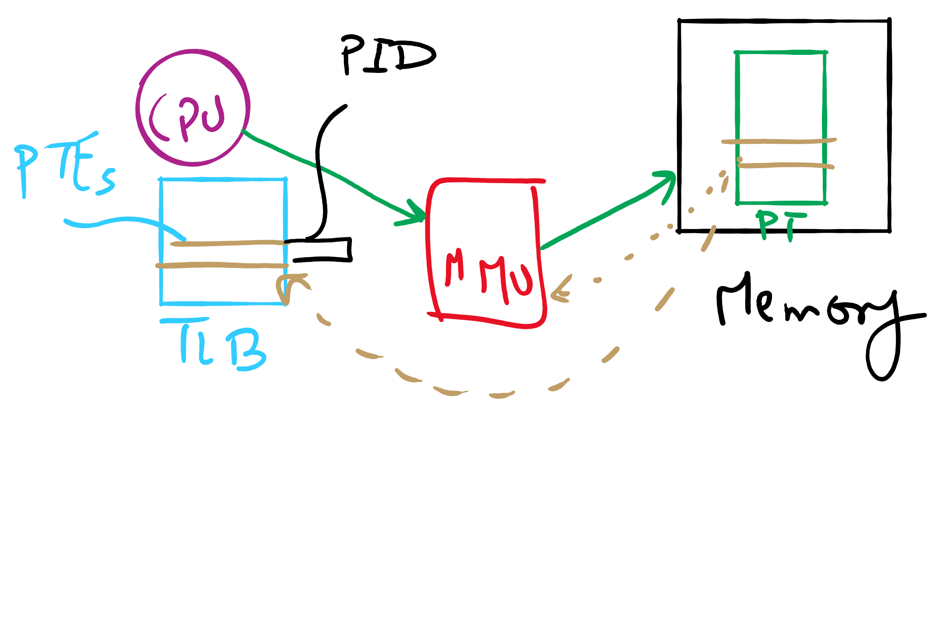
TLB

Slide 54
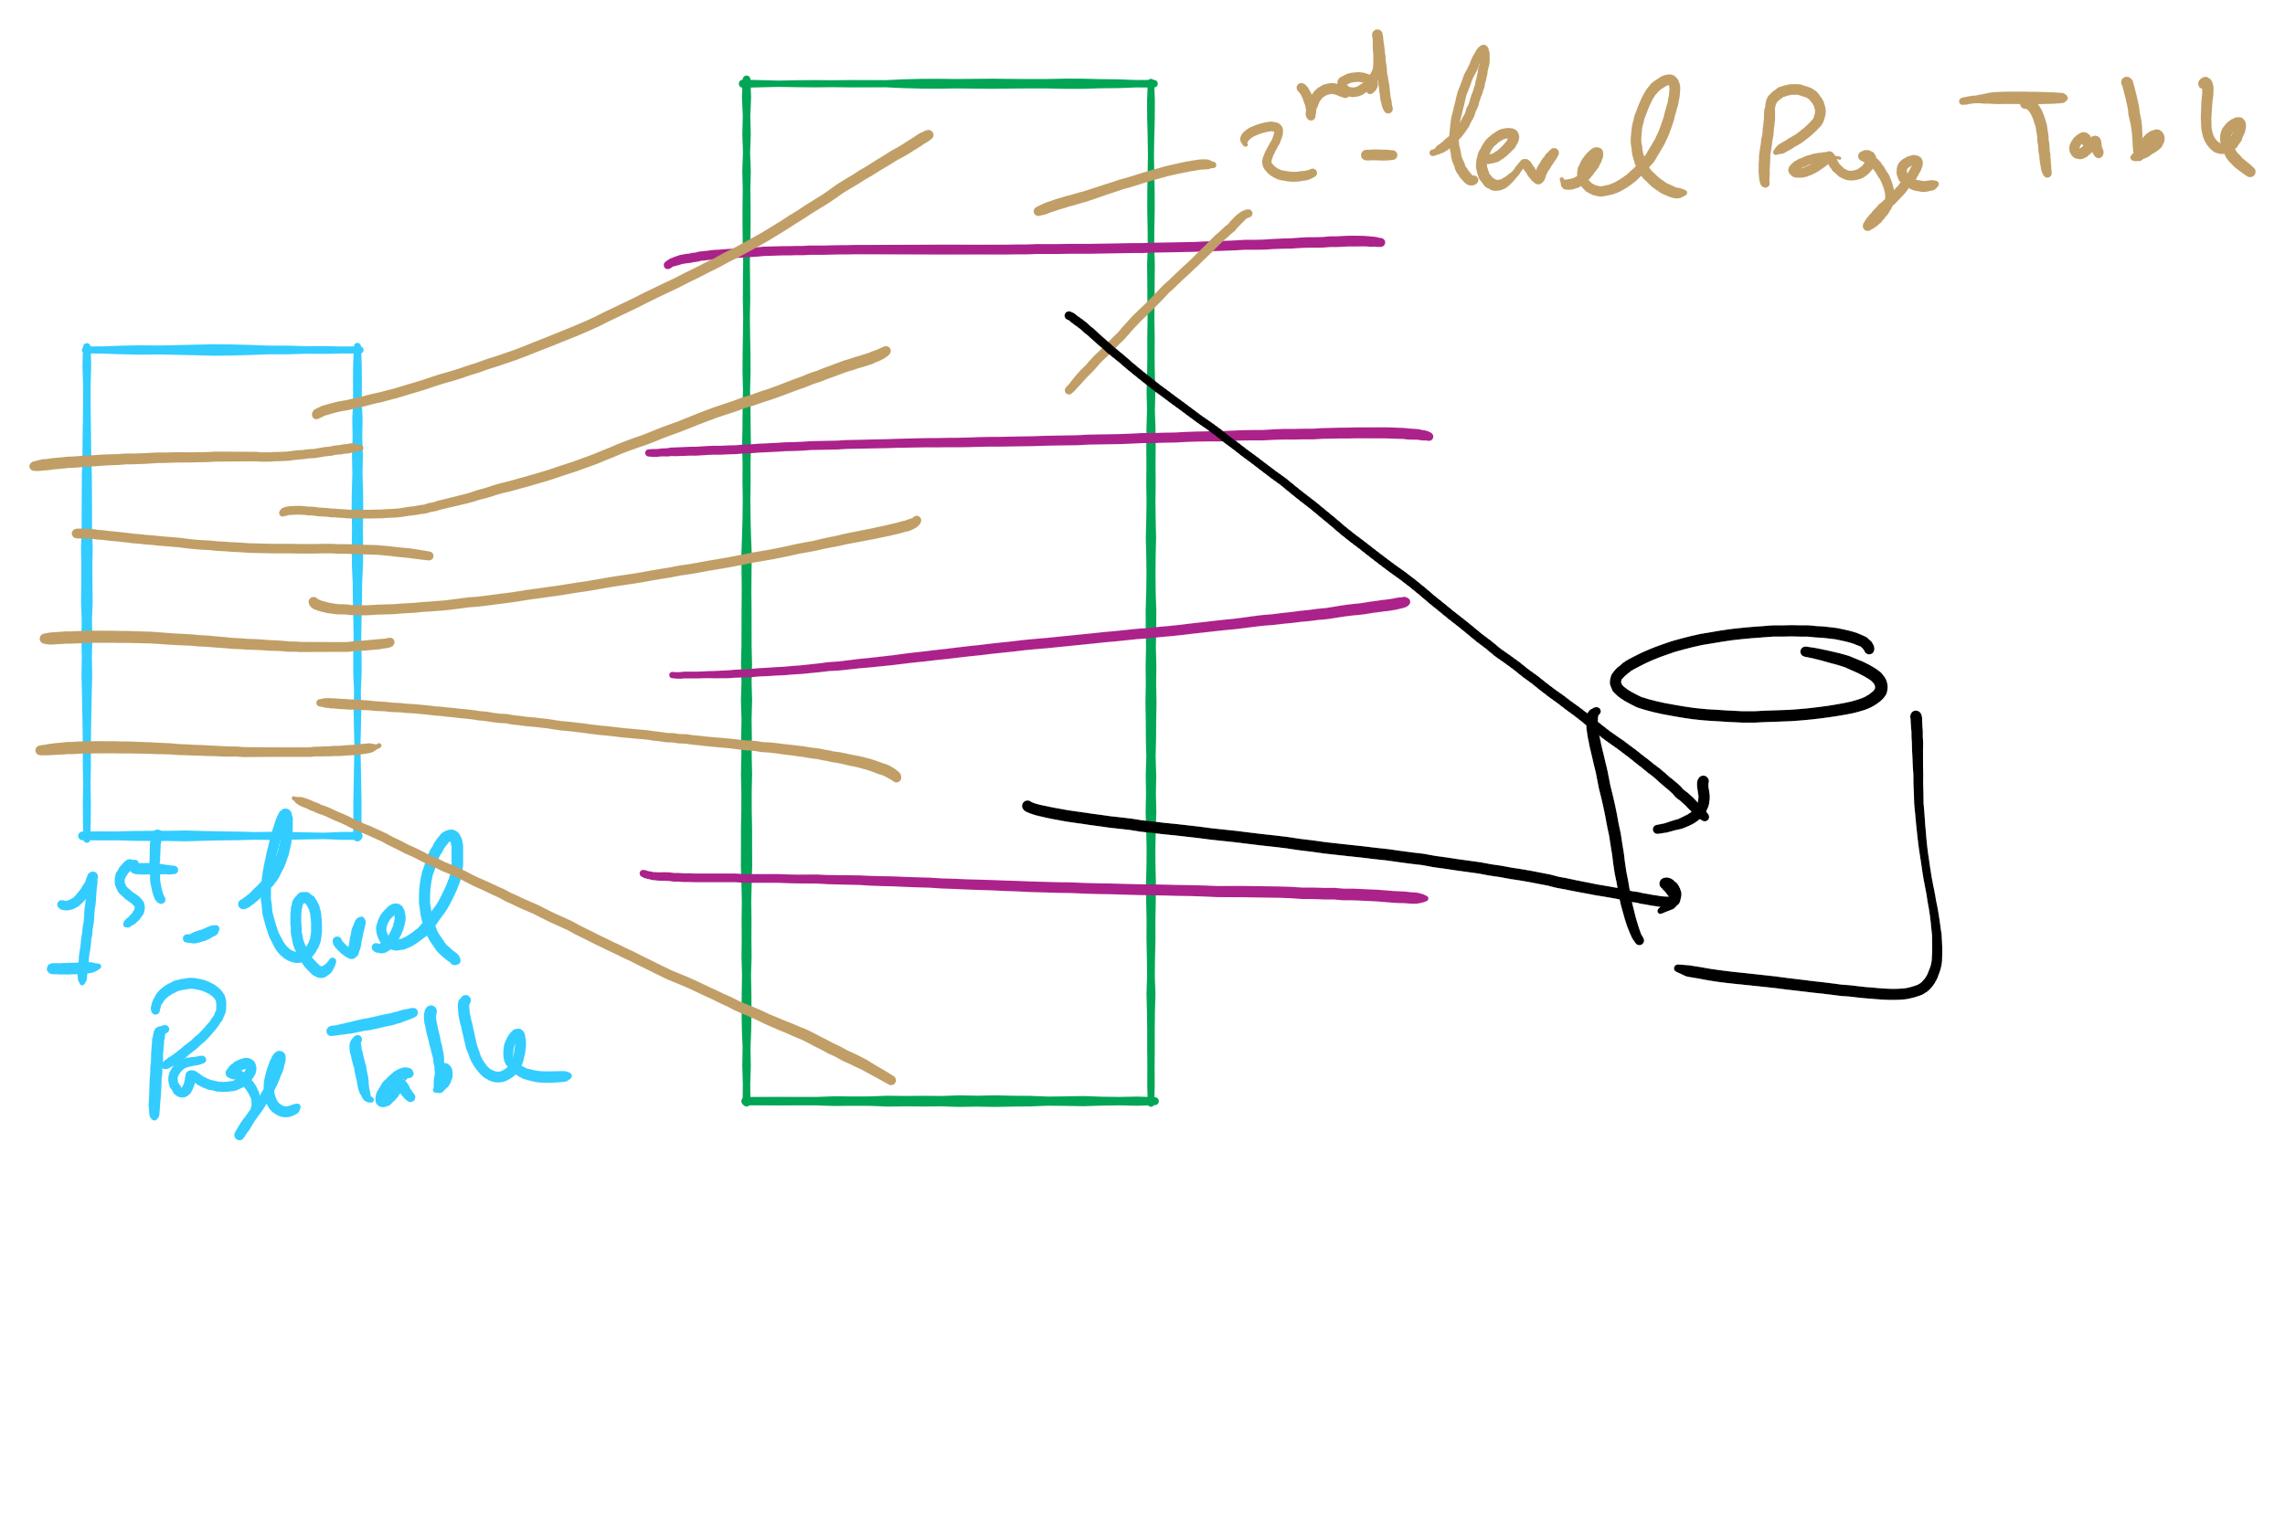
Two-level Page Table

Slide 55
Muddiest Points (2/2)
I am still confused between switching from KB or GB to bytes and where the numbers are coming from for page table size and things like that
Still a bit confused on how to calculate avg waiting time
Project 3
Could you please give a example of implementing optimal algorithm about project3
Lets say a linked list is being used as the data structure for project 3, would the number of frames a process has access to correspond to the maximum length of this list, and should the data element being checked in the nodes be the address with the offset shifted off?
Could we maybe run through how we got 24*(2^20) for the third tophat question?
pte, pte size, page size, page table size, frame size, frame numbers, frame number size... what is what and how those calculations work and relate to each other
HW 8
Question 8
Q7
HW 9
Q3 and 4
Q 10 and 11

Slide 56
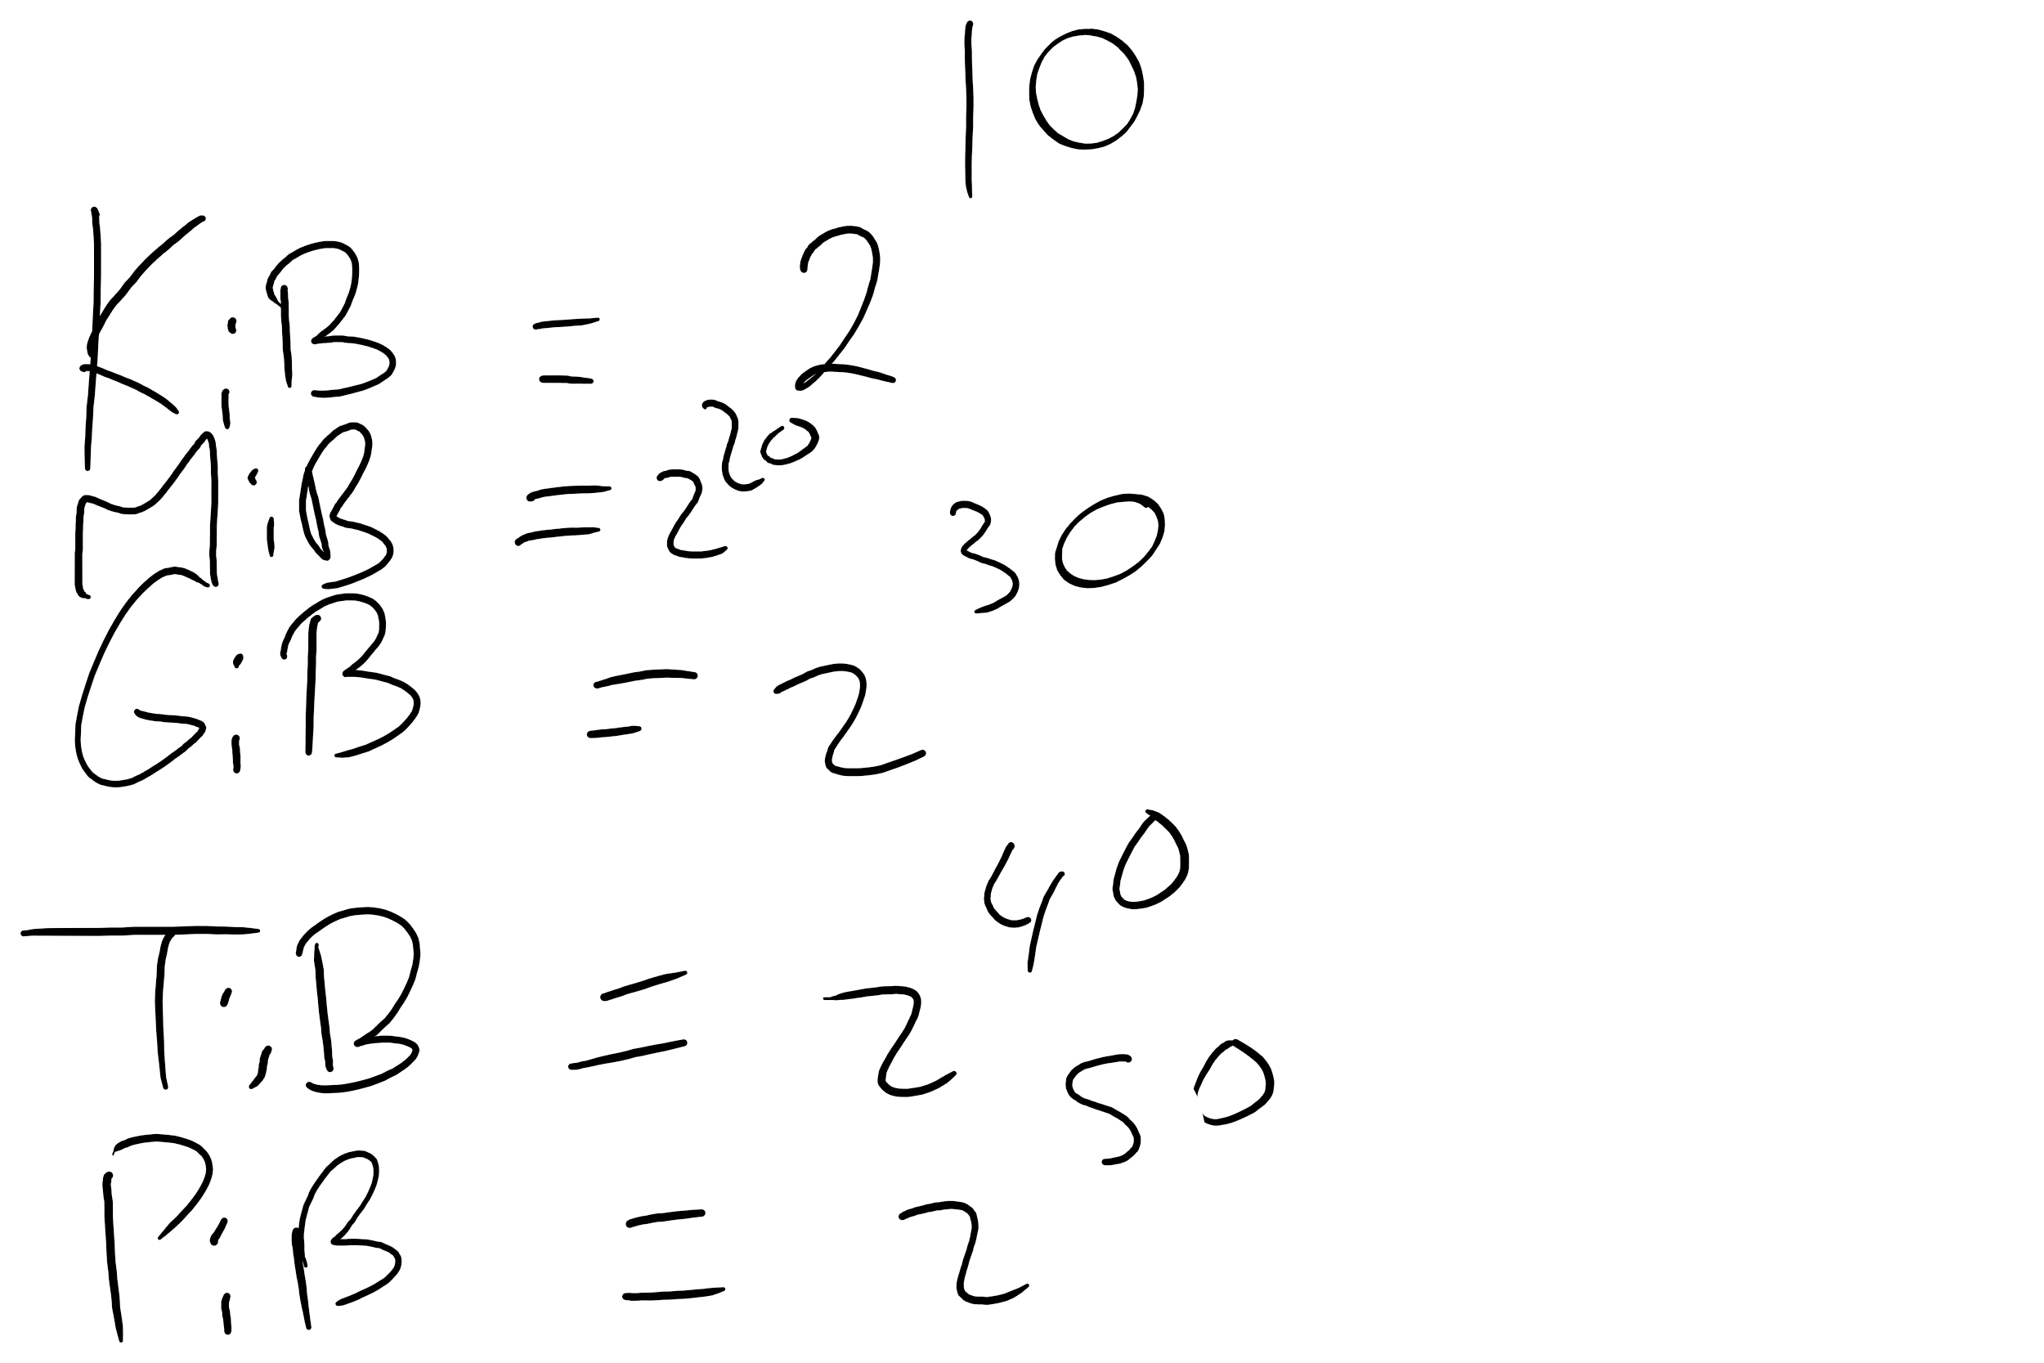
Memory Sizes

Slide 57
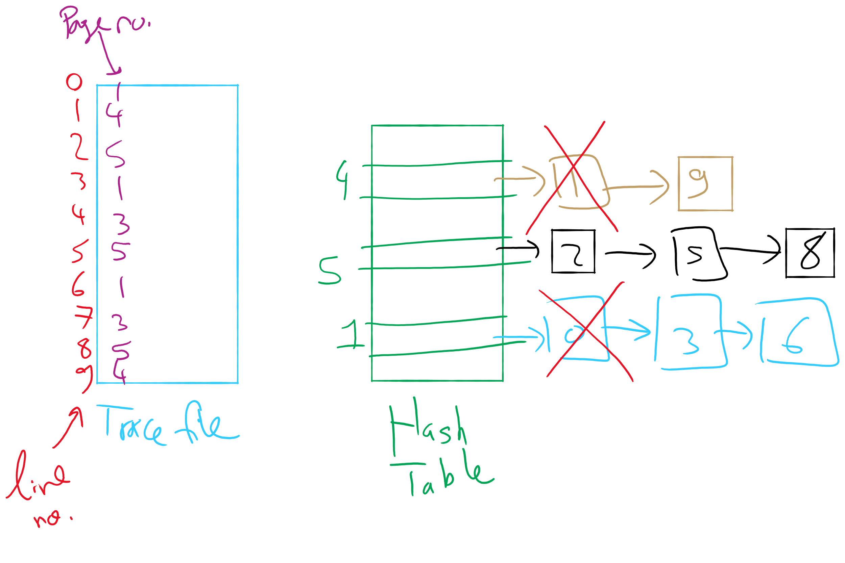
OPT Implementation Example

Slide 58
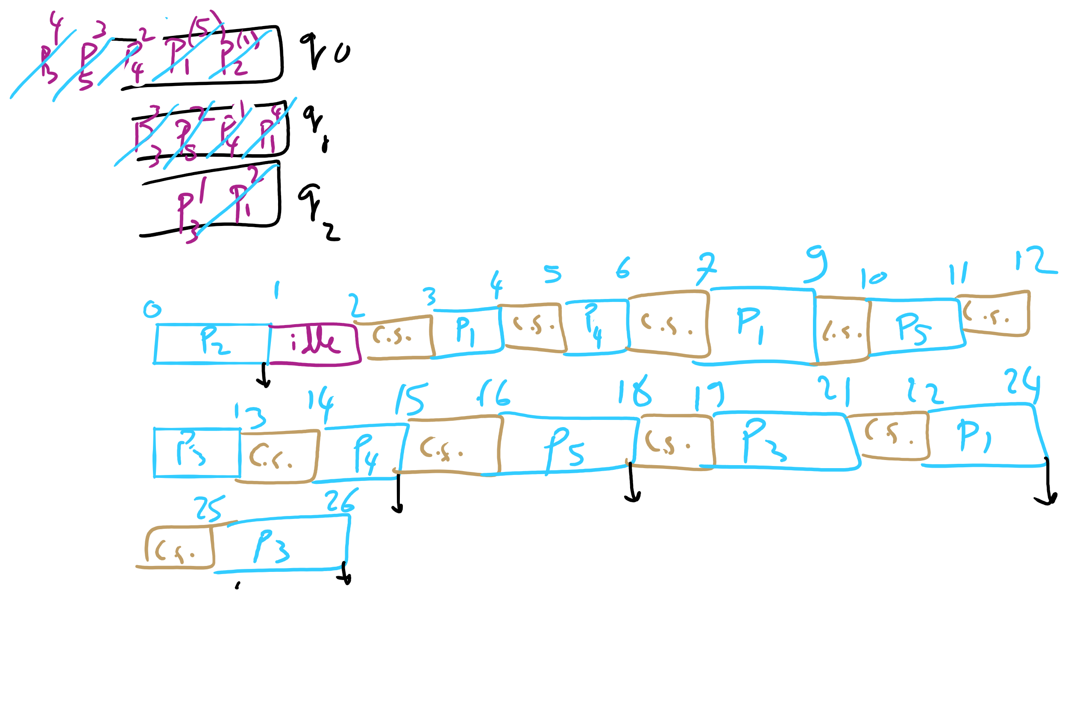
HW 8 Q1

Slide 59
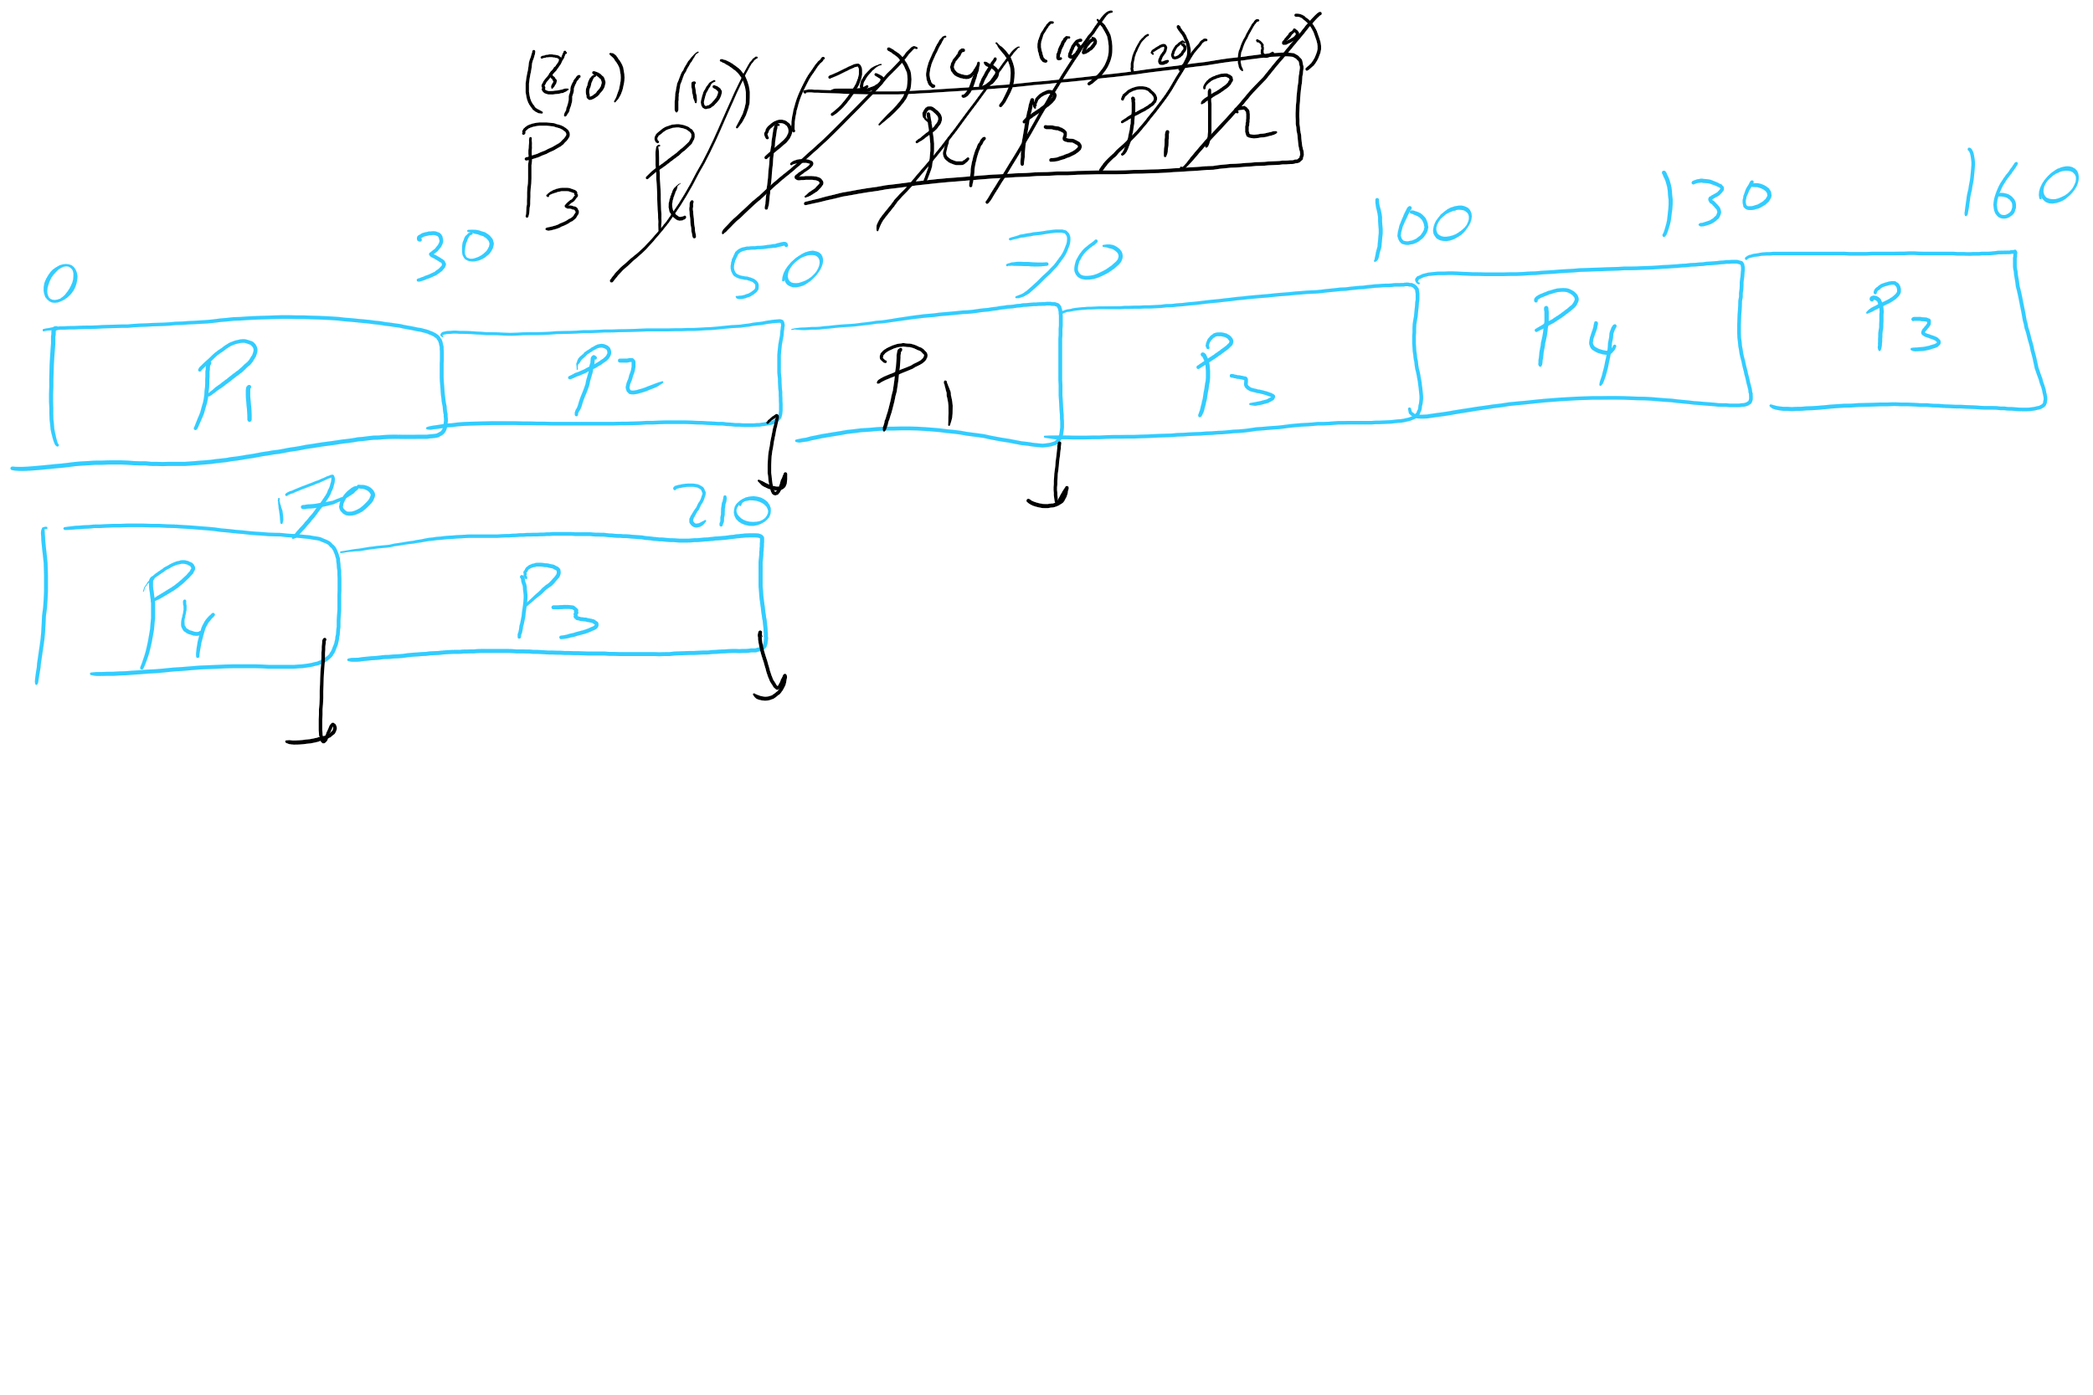
HW 8 Q6

Slide 60
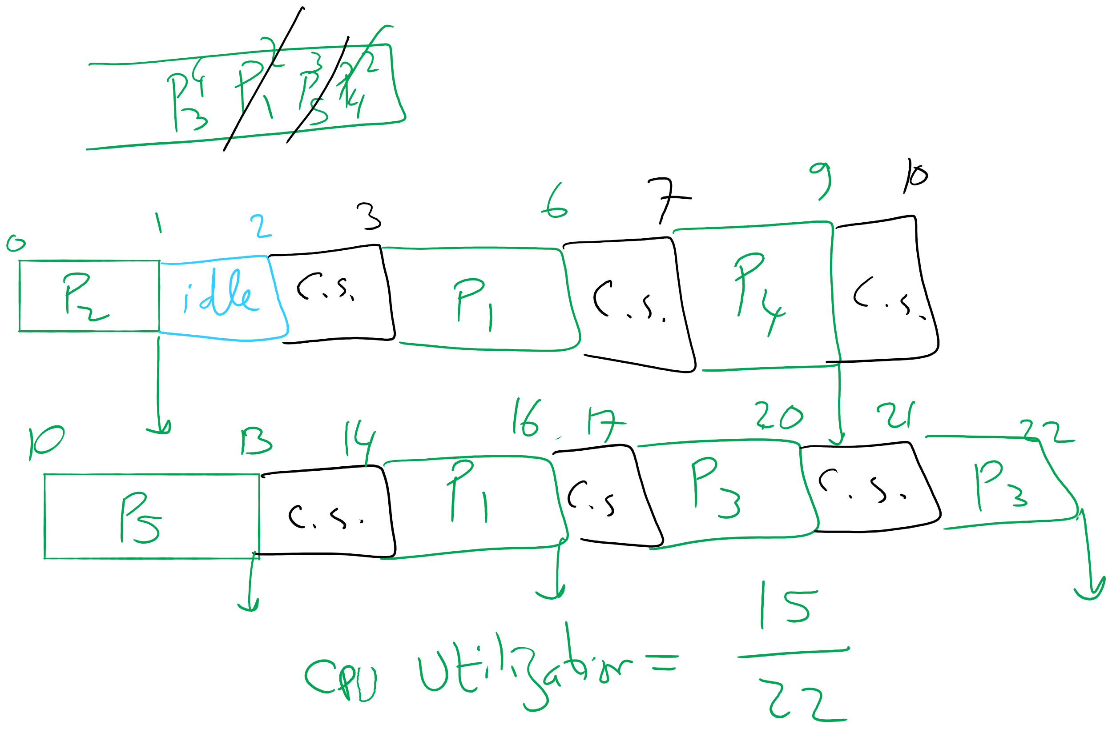
Q18,19 in HW7

Slide 61
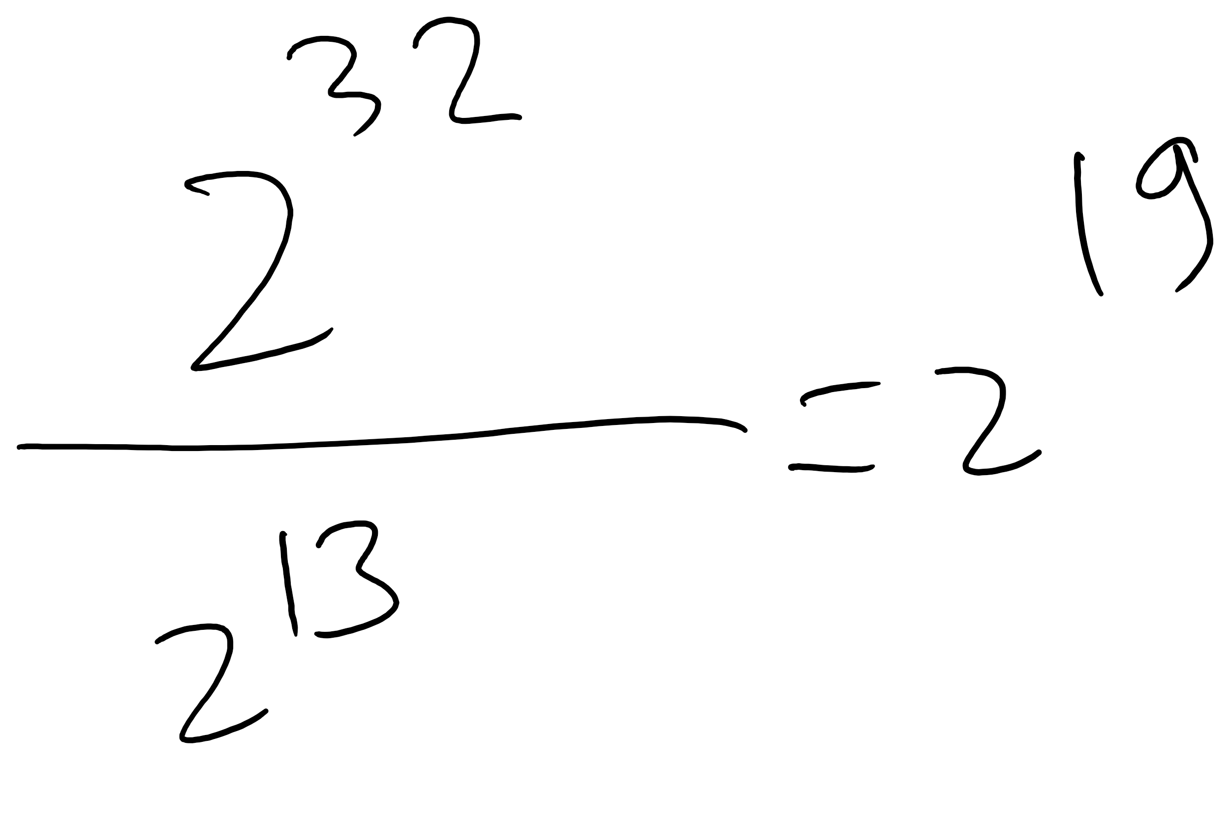
HW 8 Q 8

Slide 62
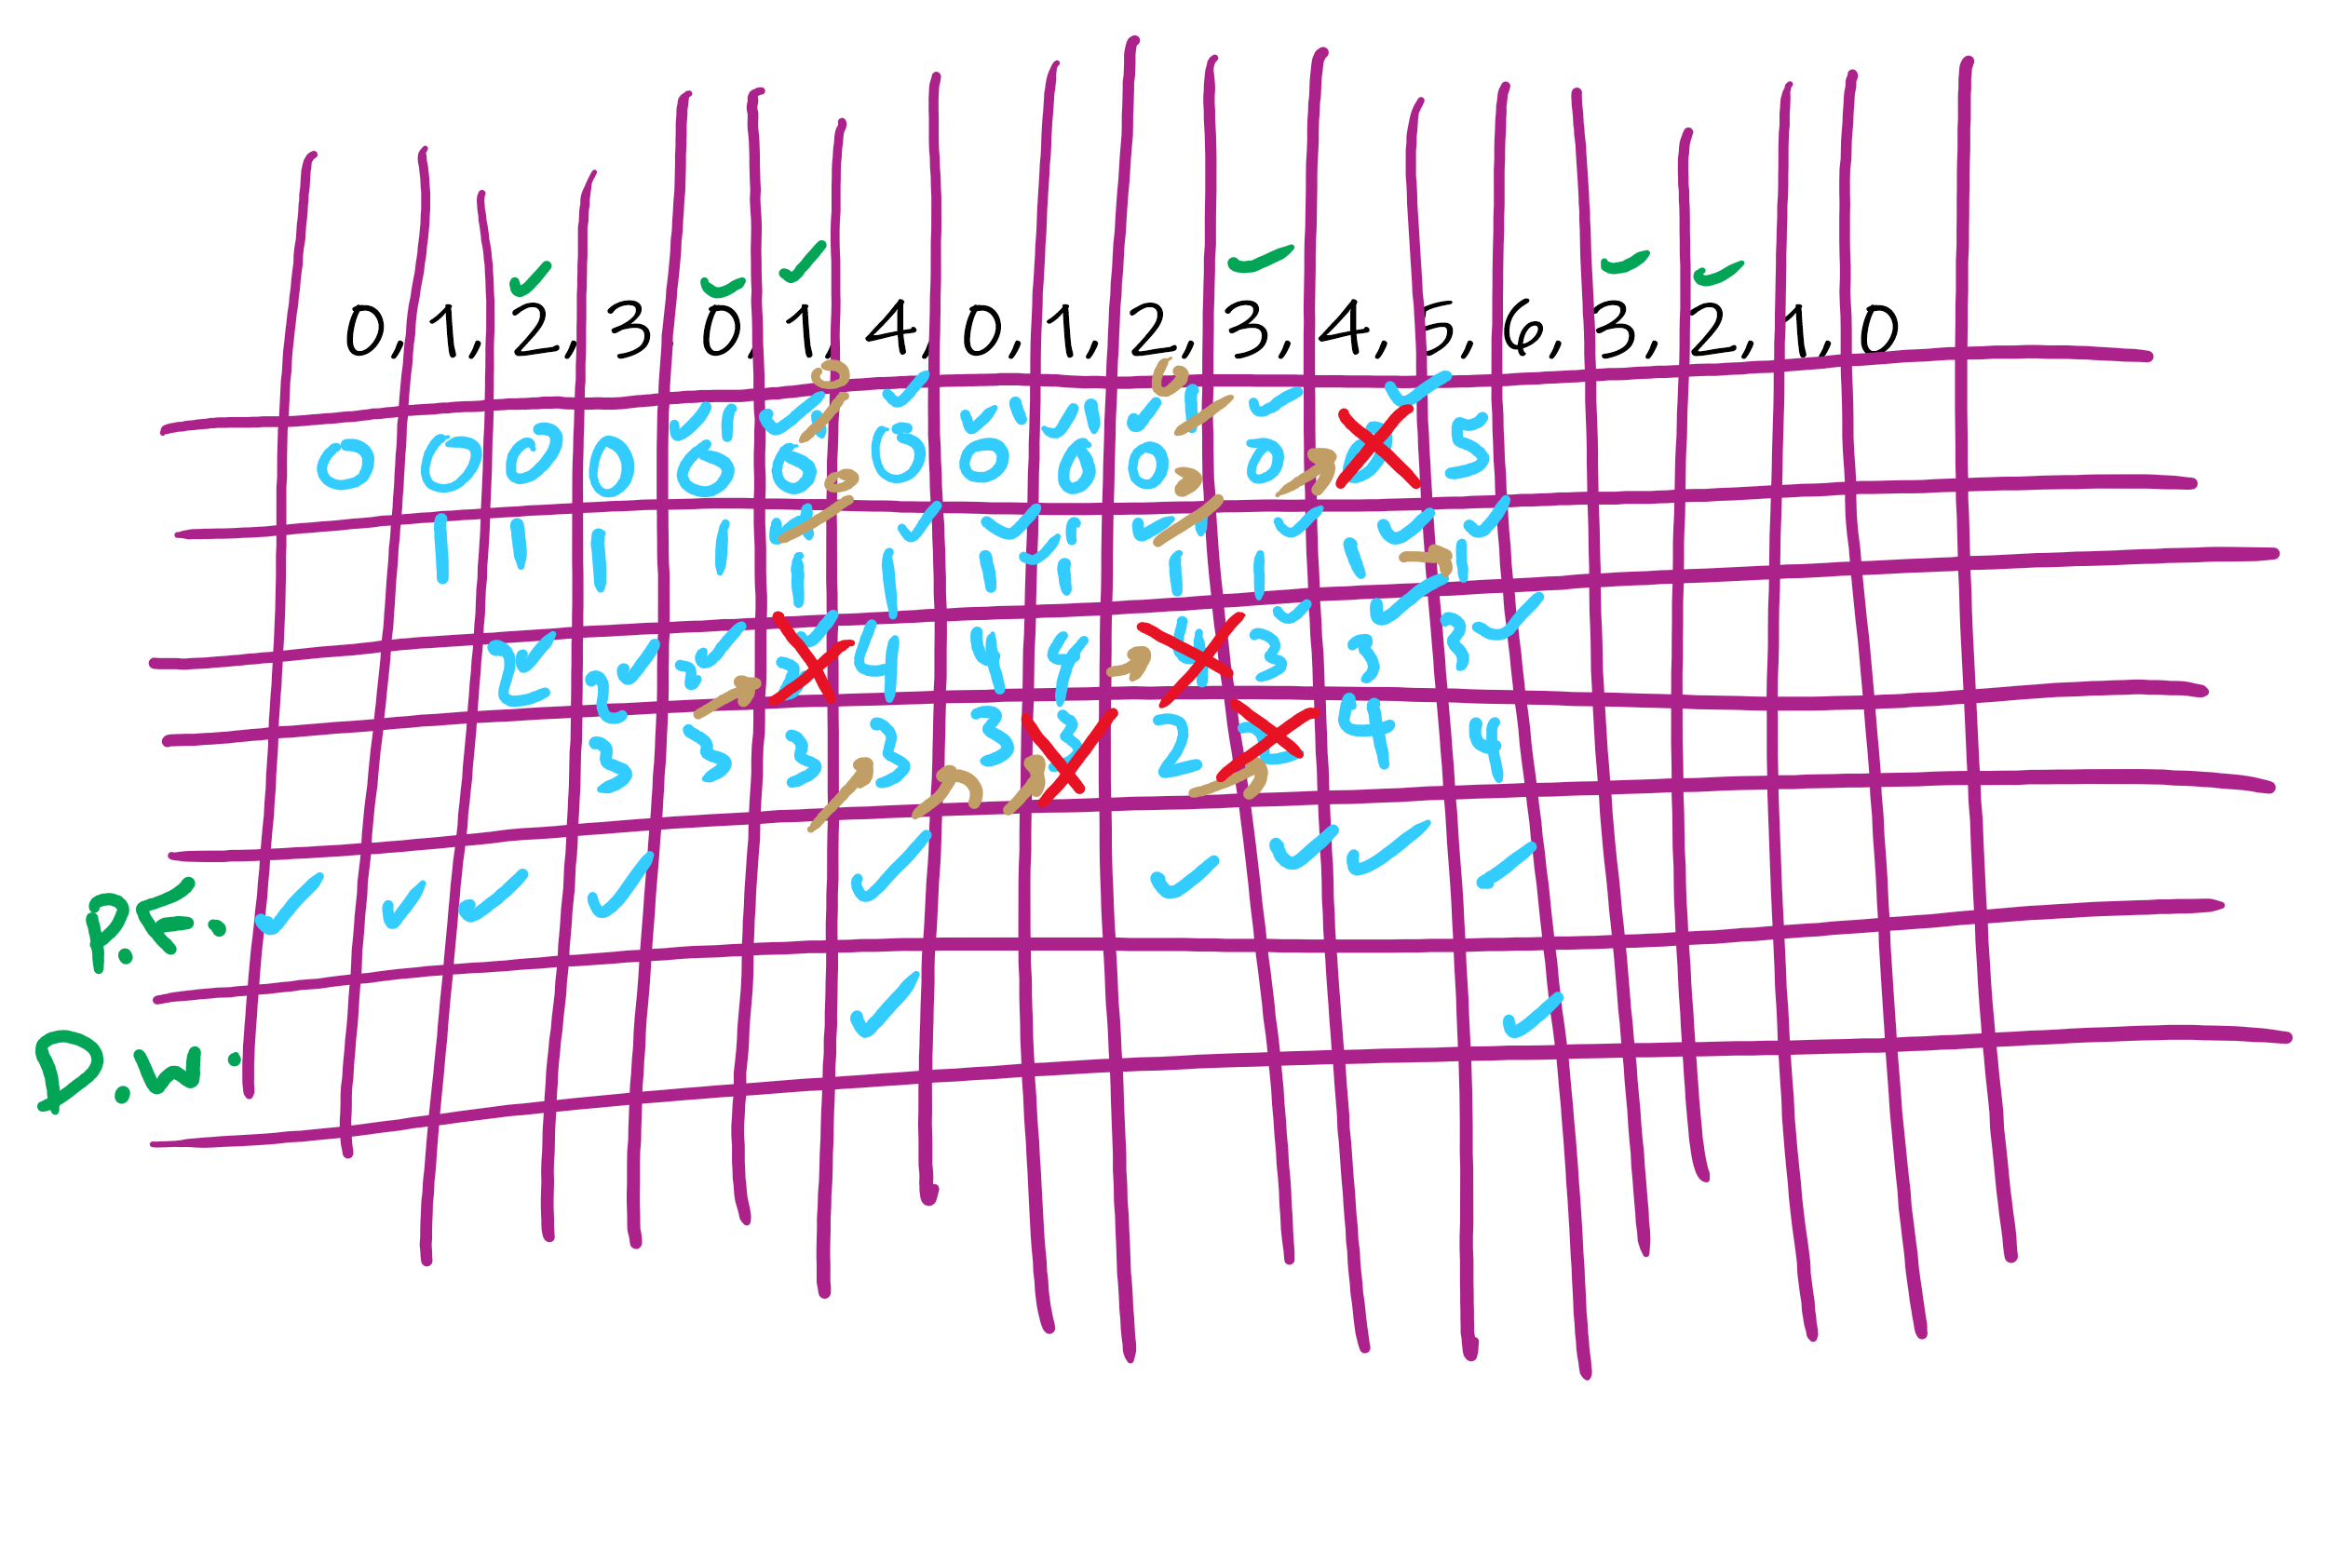
HW 9 Q 3

Slide 63
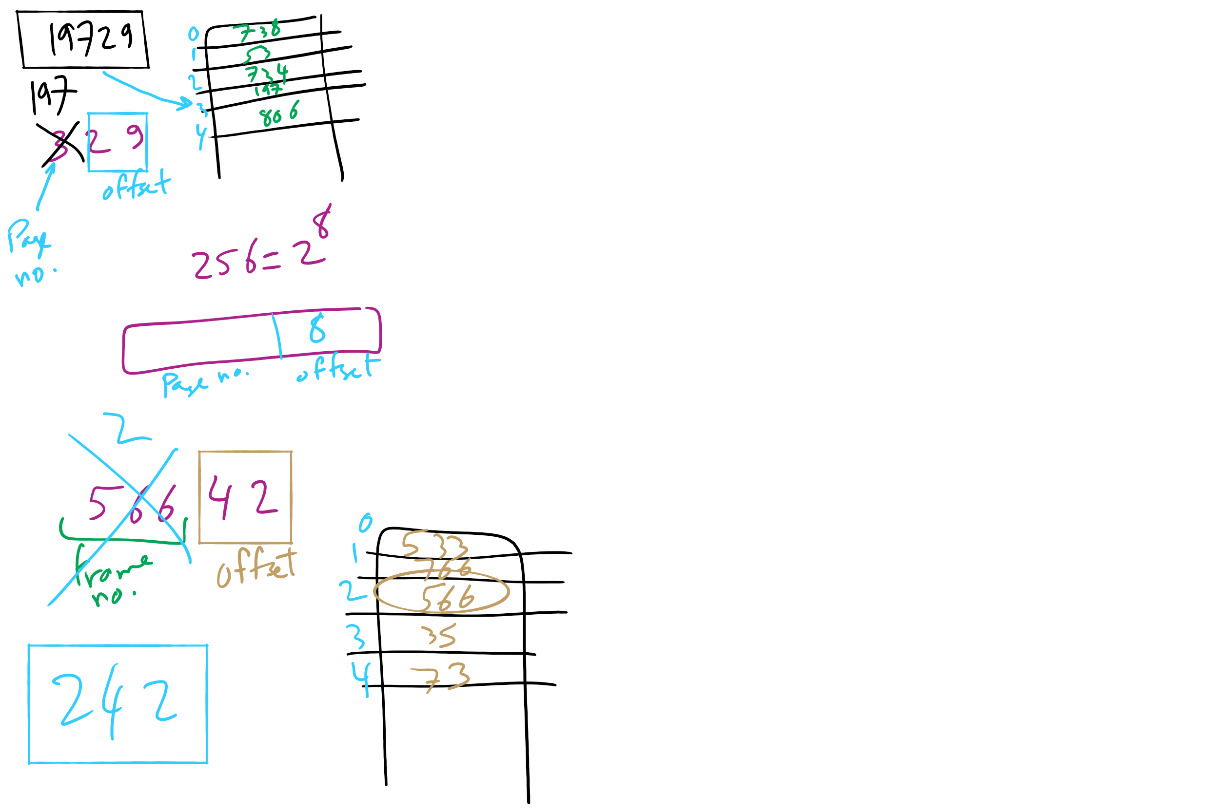
HW 9 Q 10-11

Slide 64
Today’s Agenda …
Inverted Page Table
Memory Management Issues

Slide 65
How long do memory accesses take?
Assume the following times:
TLB lookup time = a (often zero - overlapped in CPU)
Memory access time = m
Hit ratio (h) is percentage of time that a logical page number is found in the TLB
Larger TLB usually means higher h
TLB structure can affect h as well
Effective access time (an average) is calculated as:
EAT = (m + a)h + (m + m + a)(1-h)
EAT =a + (2-h)m
Interpretation
Reference always requires TLB lookup, 1 memory access
TLB misses also require an additional memory reference

Slide 66
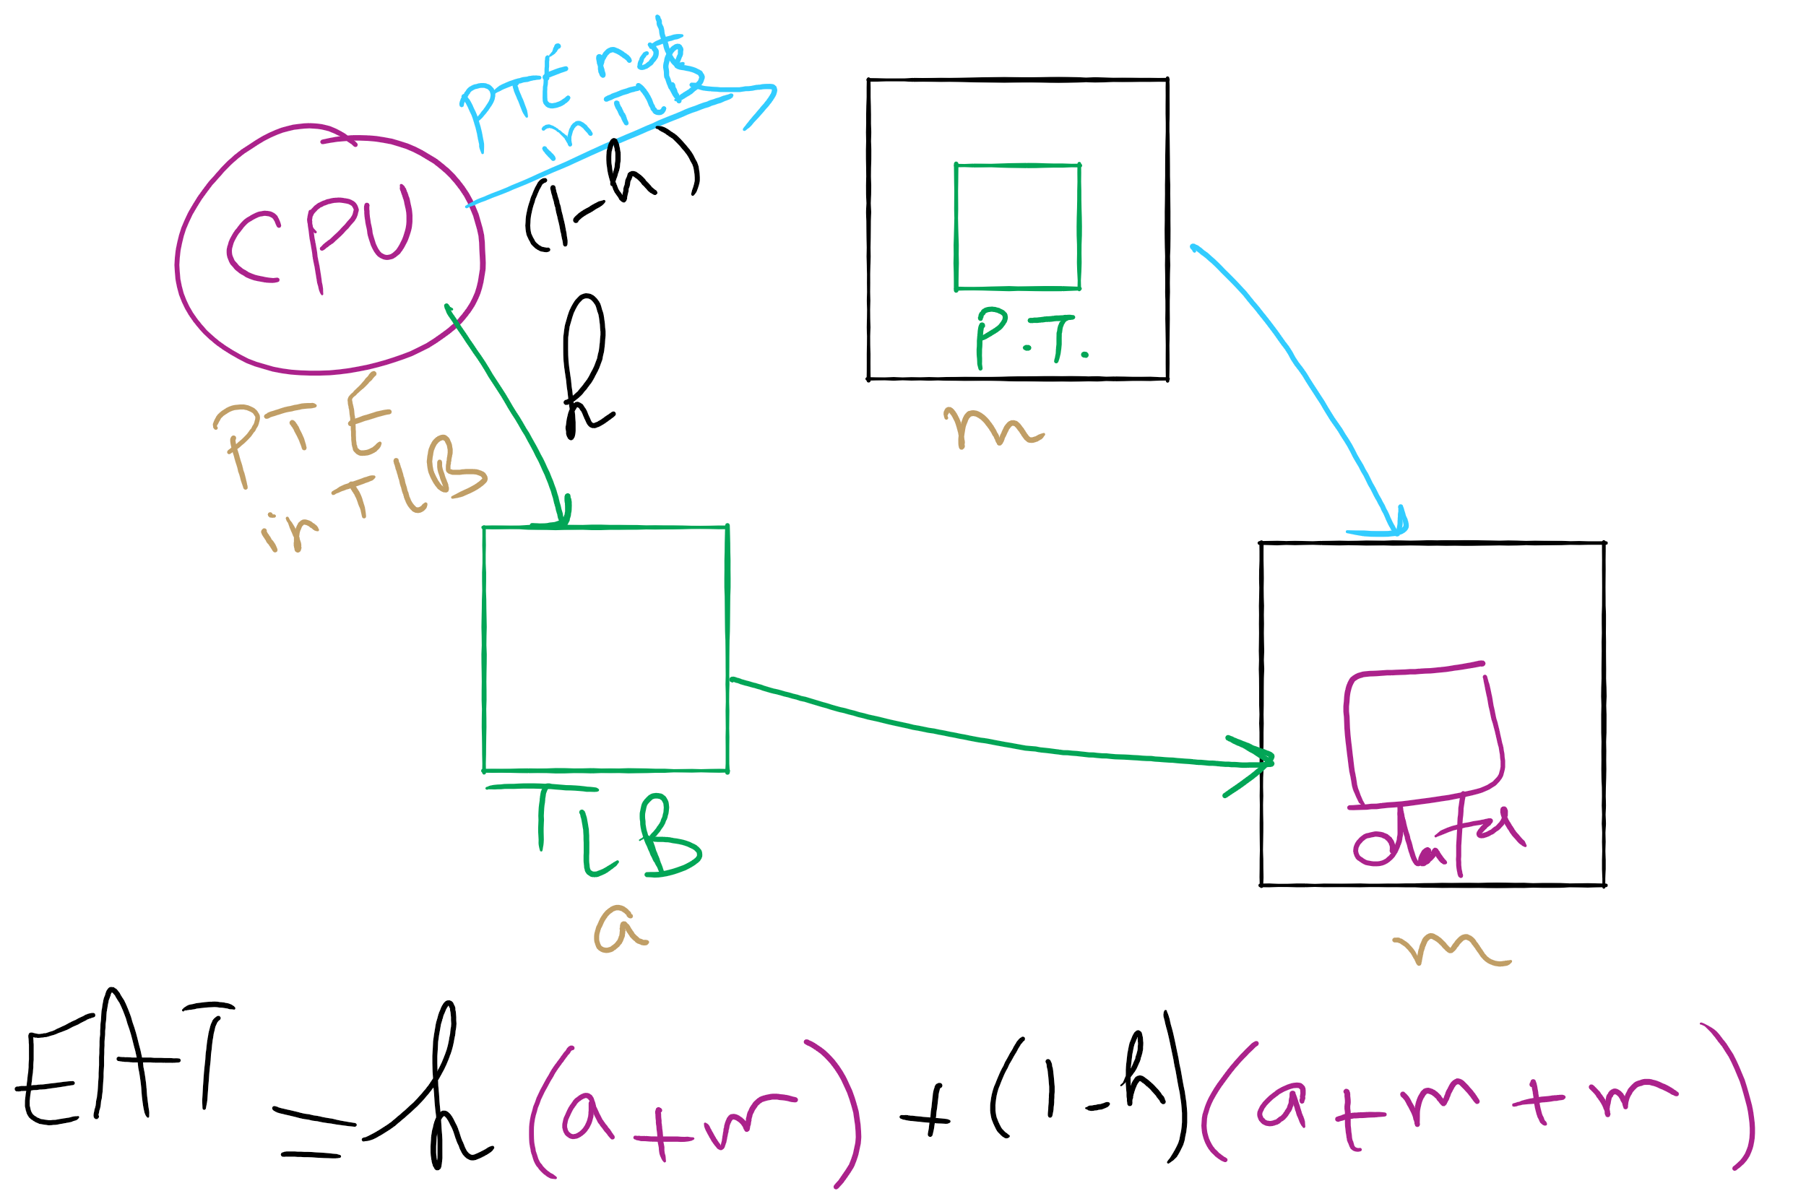
Effective Access Time

Slide 67
Inverted page table
Reduce page table size further: keep one entry for each frame in memory
PTE contains
Virtual address pointing to this frame
Information about the process that owns this page
Search page table by
Hashing the virtual page number and process ID
Starting at the entry corresponding to the hash result
Search until either the entry is found or a limit is reached
Page frame number is index of PTE
Improve performance by using more advanced hashing algorithms

Slide 68
Inverted page table architecture
page number
page offset
process ID
p = 19 bits
offset = 13 bits
Page frame number
0
pid
p
physical address
1
19
13
. . .
search
0
pid₀
p₀
1
pid₁
p₁
. . .
. . .
k
k
pid_{k}
p_{k}
main memory
. . .
inverted page table

Slide 69
Local vs. global allocation policies
What is the pool of pages eligible to be replaced?
Pages belonging to the process needing a new page
All pages in the system
Local allocation: replace a page from this process
May be more “fair”: penalize processes that replace many pages
Can lead to poor performance: some processes need more pages than others
Global allocation: replace a page from any process
Last access time
Page
A0
14
A1
12
Local allocation
A2
8
A3
A4
5
A4
B0
10
B1
9
Global allocation
B2
A4
3
C0
16
C1
12
C2
8
C3
5
C4
4

Slide 70
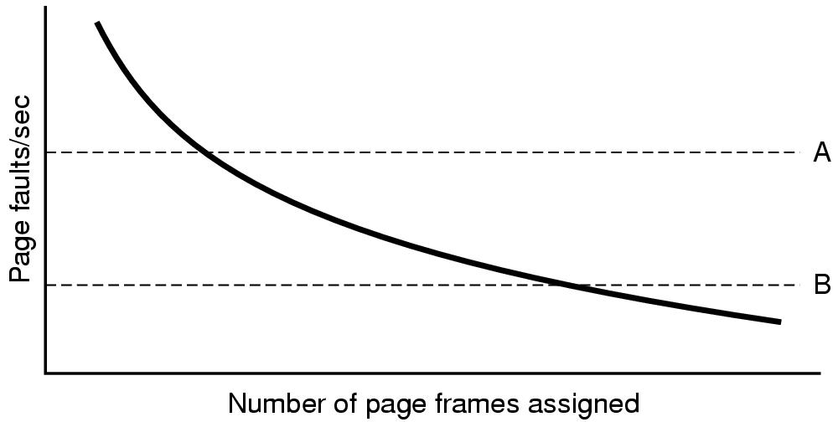
Page fault rate vs. allocated frames
Local allocation may be more “fair”
Don’t penalize other processes for high page fault rate
Global allocation is better for overall system performance
Take page frames from processes that don’t need them as much
Reduce the overall page fault rate (even though rate for a single process may go up)

Slide 71
Control overall page fault rate
Despite good designs, system may still thrash
Most (or all) processes have high page fault rate
Some processes need more memory, …
but no processes need less memory (and could give some up)
Problem: no way to reduce page fault rate
Solution : Reduce number of processes competing for memory
Swap one or more to disk, divide up pages they held
Reconsider degree of multiprogramming

Slide 72
How big should a page be?
Smaller pages have advantages
Less internal fragmentation
Better fit for various data structures, code sections
Less unused physical memory (some pages have 20 useful bytes and the rest isn’t needed currently)
Larger pages are better because
Less overhead to keep track of them
Smaller page tables
TLB can point to more memory (same number of pages, but more memory per page)
Faster paging algorithms (fewer table entries to look through)
More efficient to transfer larger pages to and from disk

Slide 73
Separate I & D address spaces
One user address space for both data & code
Simpler
Code/data separation harder to enforce
More address space?
One address space for data, another for code
Code & data separated
More complex in hardware
Less flexible
CPU must handle instructions & data differently
Instructions
Data
2³²-1
Data
Data
Code
Code
0

Slide 74
Sharing pages
Processes can share pages
Entries in page tables point to the same physical page frame
Easier to do with code: no problems with modification
Virtual addresses in different processes can be…
The same: easier to exchange pointers, keep data structures consistent
Different: may be easier to actually implement
Not a problem if there are only a few shared regions
Can be very difficult if many processes share regions with each other

Slide 75
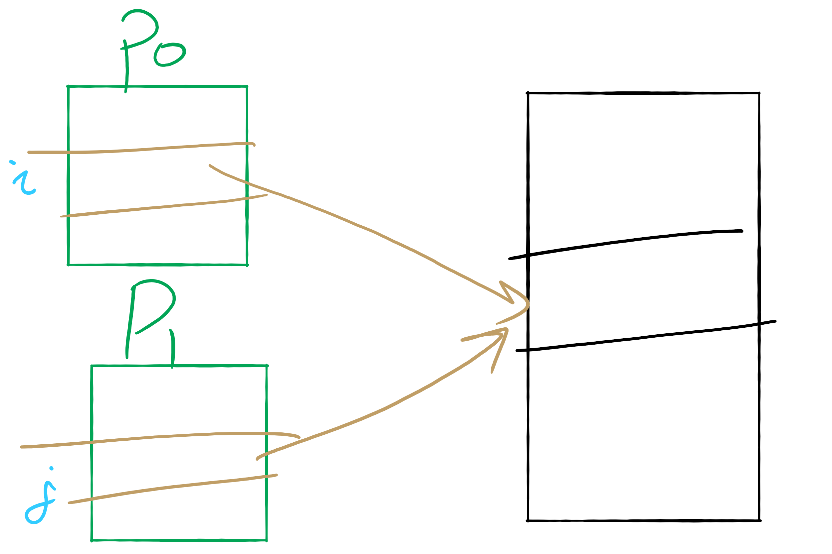
Sharing Pages

Slide 76
Implementation issues
Four times when OS involved with paging
Process creation
Determine program size
Create page table
During process execution
Reset the MMU for new process
Flush the TLB (or reload it from saved state)
Page fault time
Determine virtual address causing fault
Swap target page out, needed page in
Process termination time
Release page table
Return pages to the free pool

Slide 77
How is a page fault handled?
Hardware causes a page fault
General registers saved (as on every exception)
OS determines which virtual page needed
Actual fault address in a special register
Address of faulting instruction in register
Page fault was in fetching instruction, or
Page fault was in fetching operands for instruction
OS must figure out which…
OS checks validity of address
Process killed if address was illegal
OS finds a place to put new page frame
If frame selected for replacement is dirty, write it out to disk
OS requests the new page from disk
Page tables updated
Faulting instruction backed up so it can be restarted
Faulting process scheduled
Registers restored
Program continues

Slide 78
Backing up an instruction
Problem: page fault happens in the middle of instruction execution
Some changes may have already happened
Others may be waiting for VM to be fixed
Solution: undo all of the changes made by the instruction
Restart instruction from the beginning
This is easier on some architectures than others
Example: LW R1, 12(R2)
Page fault in fetching instruction: nothing to undo
Page fault in getting value at 12(R2): restart instruction
Example: ADD (Rd)+,(Rs1)+,(Rs2)+
Page fault in writing to (Rd): may have to undo an awful lot…

Slide 79
Locking pages in memory
Virtual memory and I/O occasionally interact
P1 issues call for read from device into buffer
While it’s waiting for I/O, P2 runs
P2 has a page fault
P1’s I/O buffer might be chosen to be paged out
This can create a problem because an I/O device is going to write to the buffer on P1’s behalf
Solution: allow some pages to be locked into memory
Locked pages are immune from being replaced
Pages only stay locked for (relatively) short periods

